Slide 1
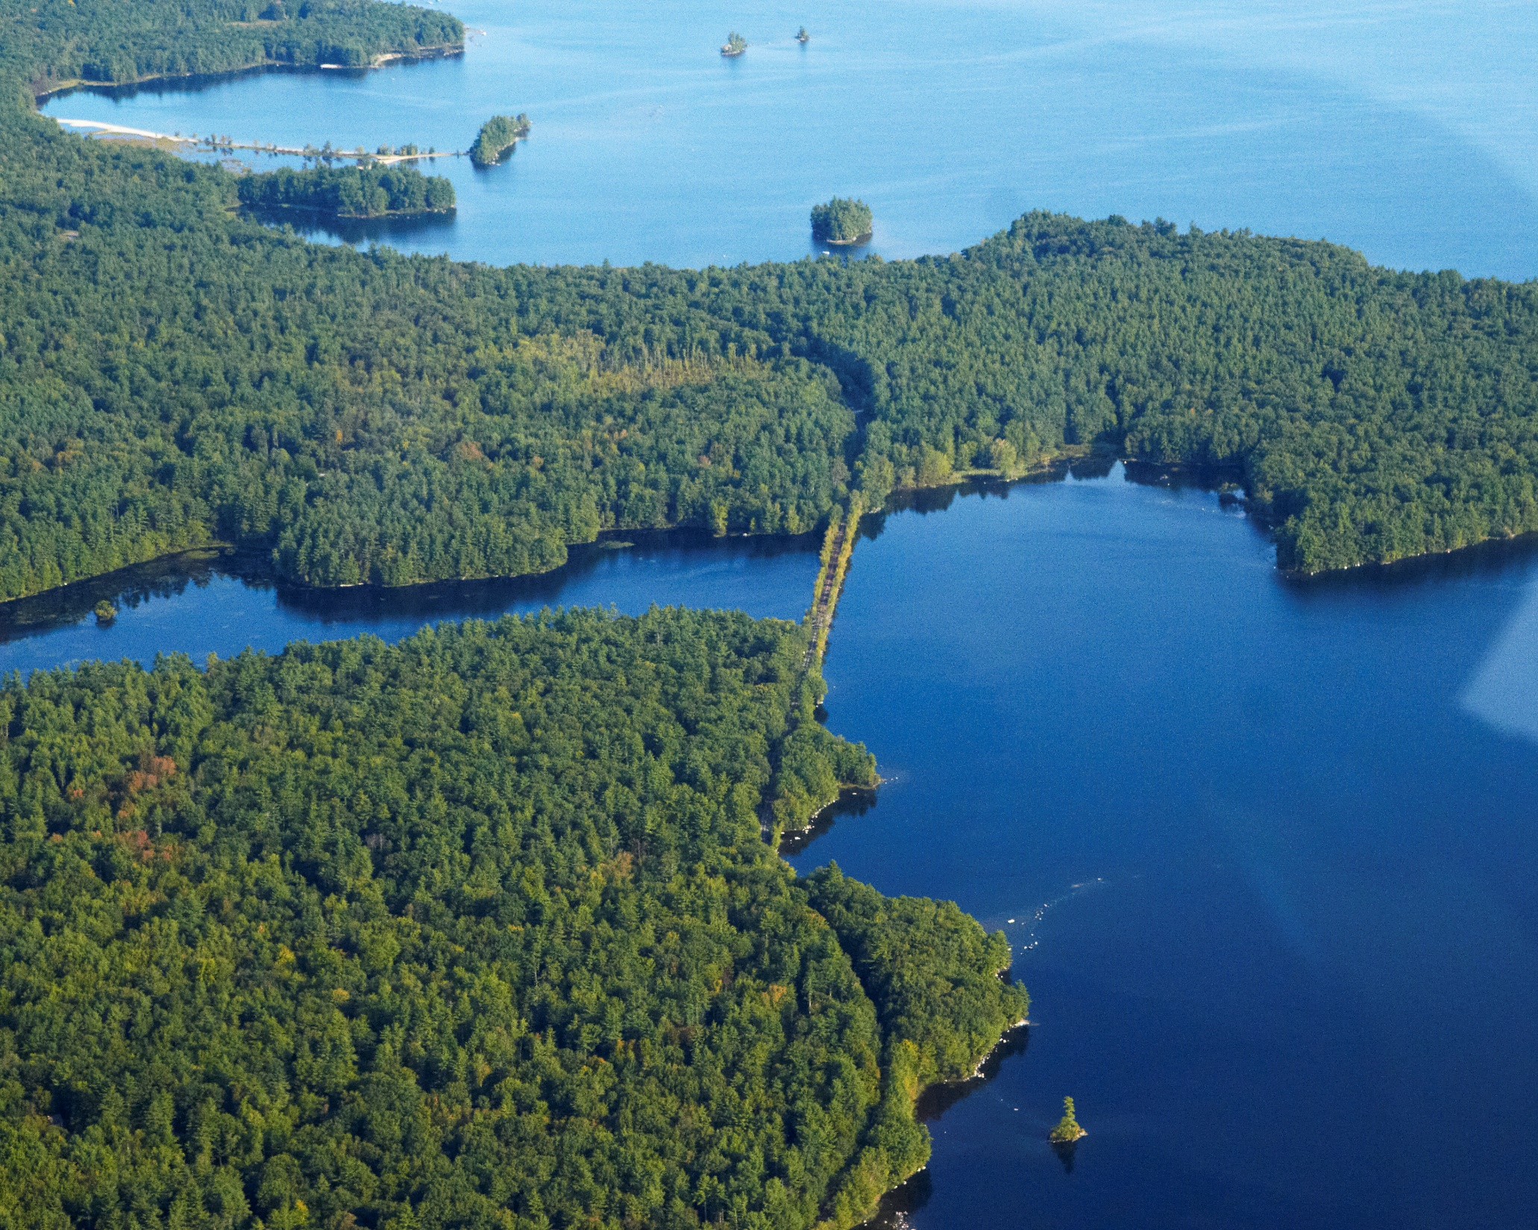
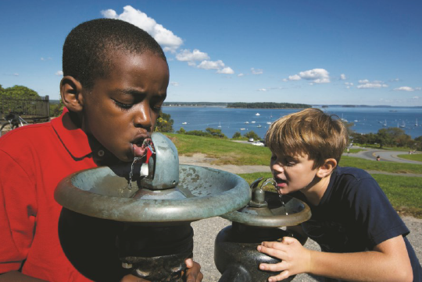
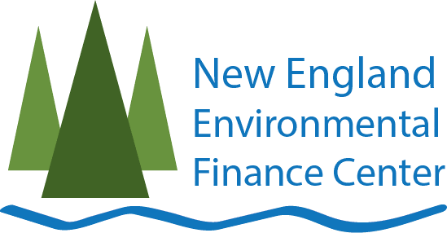
Protecting Maine’s Drinking Water: Land Trust -Water Utility Collaborations

Slide 2
Responsibilities of a small drinking water utility operator
Unique challenges
Many and various tasks
1,900 public water systems - Most are small or very small systems
Short on time, money, and capacity

Slide 3
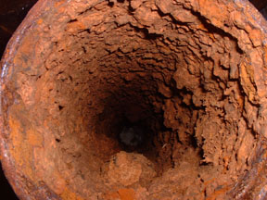
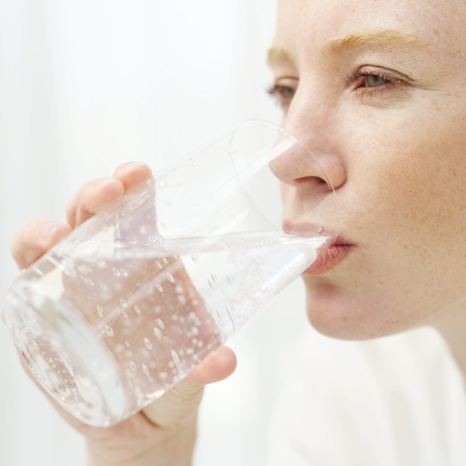
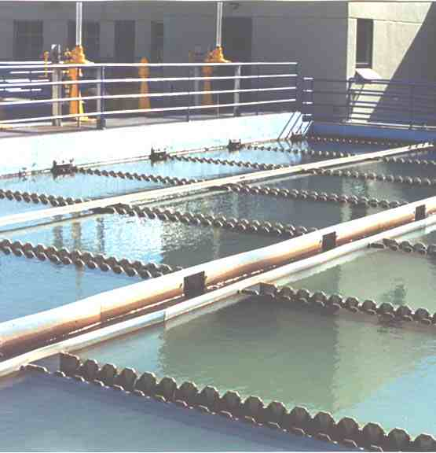
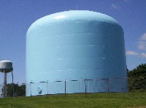
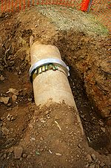
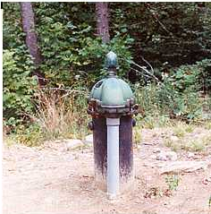
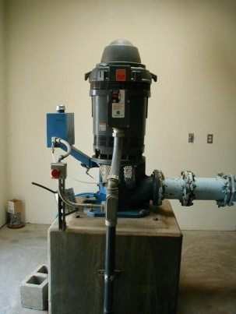
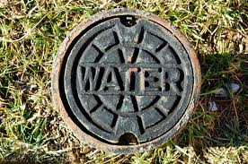
Water Utility Tasks
Notes:
Operation and maintenance
Routine sampling for regulated contaminants
Monthly operating reports (if adding chemicals)
Yearly Consumer Confidence Reports (to DWP and consumers)
Public notices of violations
Be ready for Sanitary Surveys and inspector visits
Achieve training credits to keep operator licenses
SOURCE WATER PROTECTION
Maine DWP emphasized SWP as the number one priority for systems, followed by sampling, maintaining equipment and inspecting and replacing infrastructure. Reality is a bit different – daily tasks take over.
DWP encourages wellhead protection plans or source (surface water) watershed plans, but not all systems have those.

Slide 4
The Benefits of Source Water Protection
FOR WATER UTILITES:
Clean water = less treatment
Utilities know their:
Water Quality challenges
Land use practices in the watershed
Priority protection areas
FOR LAND TRUSTS:
Clean Water Partners
Mutual support for shared goal
Possible new source of funding
Notes:
Water filtration is expensive! 9 water departments/districts have EPA filtration waivers in Maine. Super valuable, and they don’t want to lose those. Protecting the drinking water source area is far more economical than treating contaminated water. EPA estimates that TREATING contaminated groundwater supplies is 30-40 times more costly that preventing contamination.
Water systems in Maine: Maine has nearly 1,900 public water systems that use surface or groundwater. Many (not all) have wellhead protection plans (groundwater) or Watershed management plans (surface water). Most are small or very small systems.
There is something to be gained by both entities if they put their heads together

Slide 5
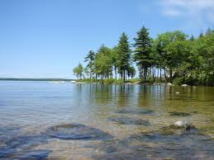
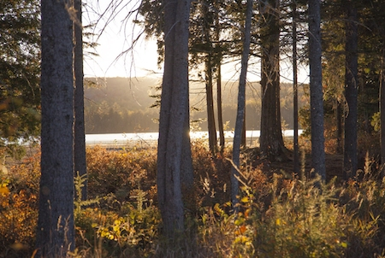
A WIDE spectrum of scenarios
Long history of water protection
with
many
partners…
May own land in the watershed,
but do
not have it
permanently
conserved
Doesn’t
Want to
be in
the land
management business

Slide 6
Common Goals
Water Utilities
Land Trusts
Water Utilities
Land Trusts
Protect water quality
Land acquisition & management
Work with
municipalities
Grant writing
Promote public health
Education/outreach
Protect clean water source
Limit access
Take samples
Maintain treatment
Inspect infrastructure
Fundraising
Recreation/access
Purchase/easements
Education
Land management
Notes:
We held some rountables to figure out shared goals, and there are many. But there are also barriers that may be significant including culture, language, and priorities (access is a big one – land trusts want to give public access, while utilities want to keep access by the public out).

Slide 7
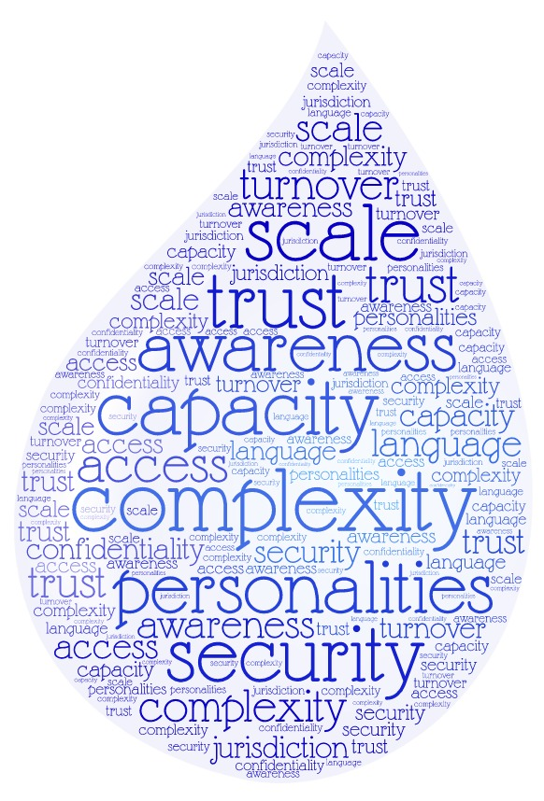
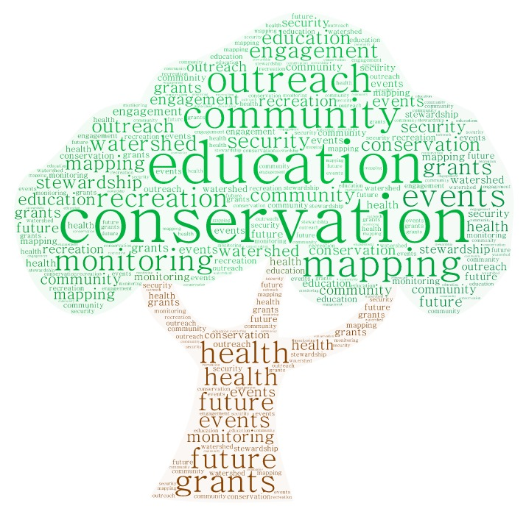
Common Goals

Slide 8
Spectrum Opportunities/Challenges
Talk Funding Opportunities
Connect
& Talk
Discover Shared Goals
Discover Mutual Benefits
Notes:
Connect & talk about the benefits of conserving land to protect drinking water supply. Same language? Same culture? Same goals?
Identify projects or actions that benefit both of you.
Is there capacity at the utility? At the land trust?
Learn about water quality issues in the watershed and priority areas that the utility wants to protect.
Are they similar to land trust’s goal?
Learn what the utility can finance.
Can the land trust leverage that investment?

Slide 9
How to start collaborating Bit.ly/pwsmapping
Notes:
Shows Land Trust service areas, conserved lands, and source water protection areas

Slide 10
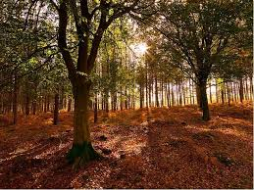
Utility Financing Option - new
PWS can receive financial support to protect land in Source Water Protection area
The loan is eligible for 50% principal forgiveness of up to $50,000

Slide 11
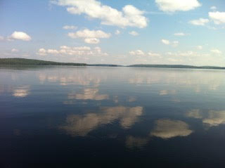
Collaboration allows:
Opportunity to join forces
Presentation of a unified front
Leveraging of funds to protect more together than you could alone
Partners to do what they do best!

Slide 12
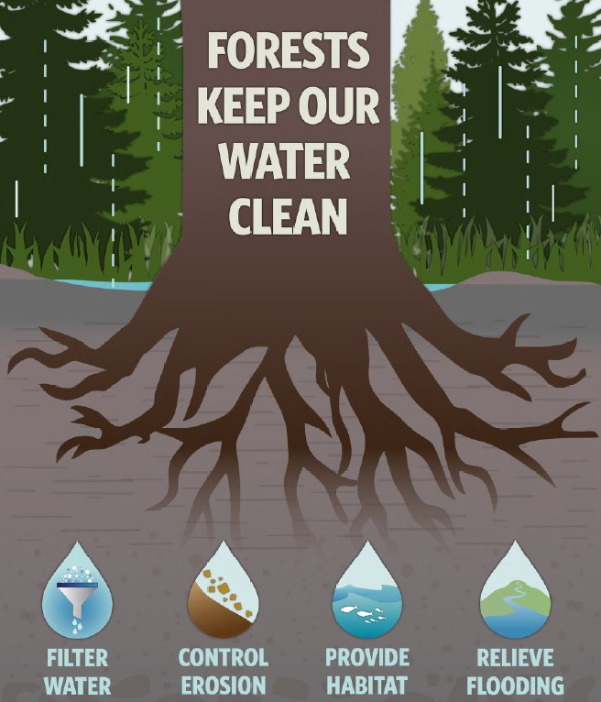
Sebago Clean Waters
Water-driven – primary focus is on water quality – numerous additional benefits (community well-being, vibrant economy, fish/wildlife/habitat)
Watershed-based – goal to protect 25% of the Sebago Lake watershed – as forests – highest priority lands
Landscape-scale –
35,000 acres
in the next 15 years
Collaborative –
9 partner
organizations
Grant

Slide 13
Sebago Lake & PWD
Supplies water to 1/6 of Maine’s population and its fastest growing businesses
EPA Filtration Avoidance Waiver (~$150M to build filtration plant)
6.5B gallons in 2016
52% residential users
22% to top 10 largest water users
Watershed is 84% forested – only 10% conserved; Water quality degradation predicted below 76% forested
PWD has pledged to fund up to 25% of each conservation project that meets their water quality criteria

Slide 14
Water Fund

Slide 15
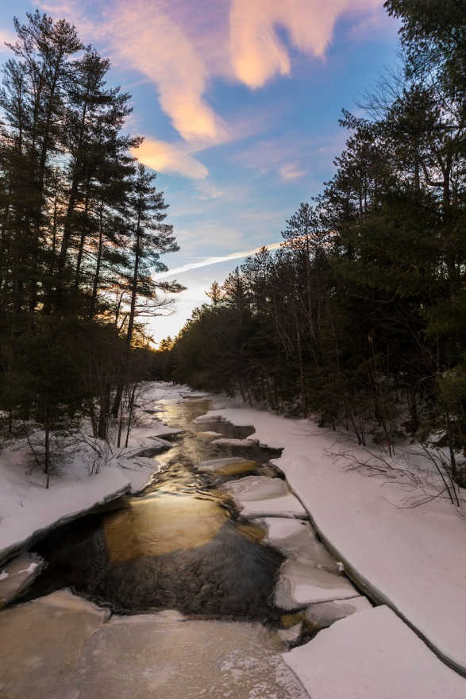
Water Quality as a Conservation Target
Broaden relevance/reach
Water quality as top environmental priority for public
Clean water is critical to business
Attract new and different funders
Attract new and different partners

Slide 16
Portland Water District Partnership
Commitment of up to 25% of funding for land conservation
Technical expertise
Different voice/perspective & community relationships
Complimentary erosion control and other water quality protection work
Outreach and education
School education
Drinking Water Week
Bill stuffer

Slide 17
Breweries as New Partners

Slide 18
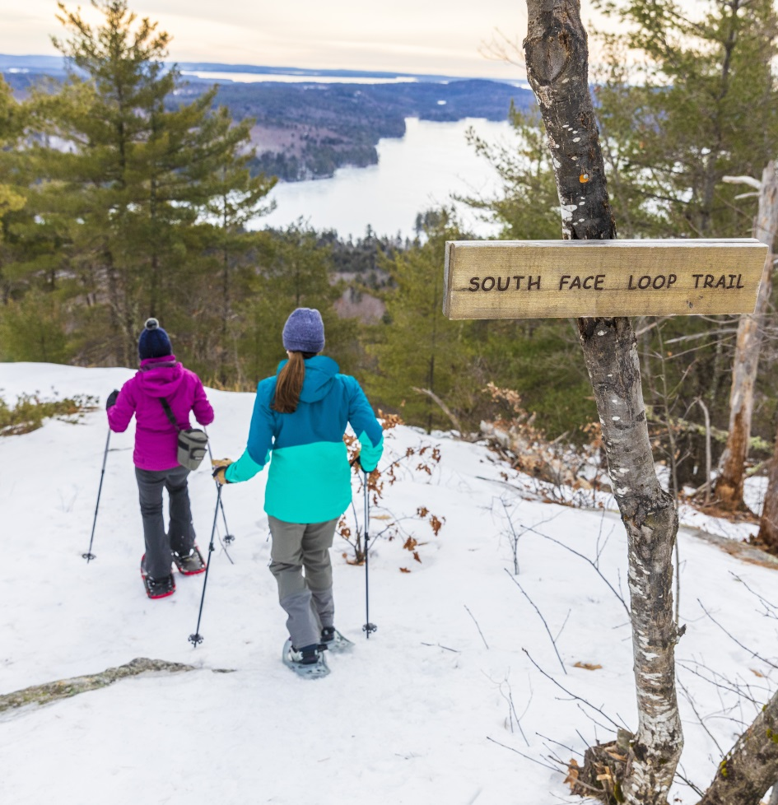
Take-aways
Water districts – complementary missions - different lens
Examples - Farmland conservation
- Project criteria
Other new partners – broaden thinking & language
Business examples
- Every $1 invested in Sebago watershed conservation yields up to $8 in benefits
- Investment in land conservation = future costs avoided
Pace of conservation vs. pace of business

Slide 19
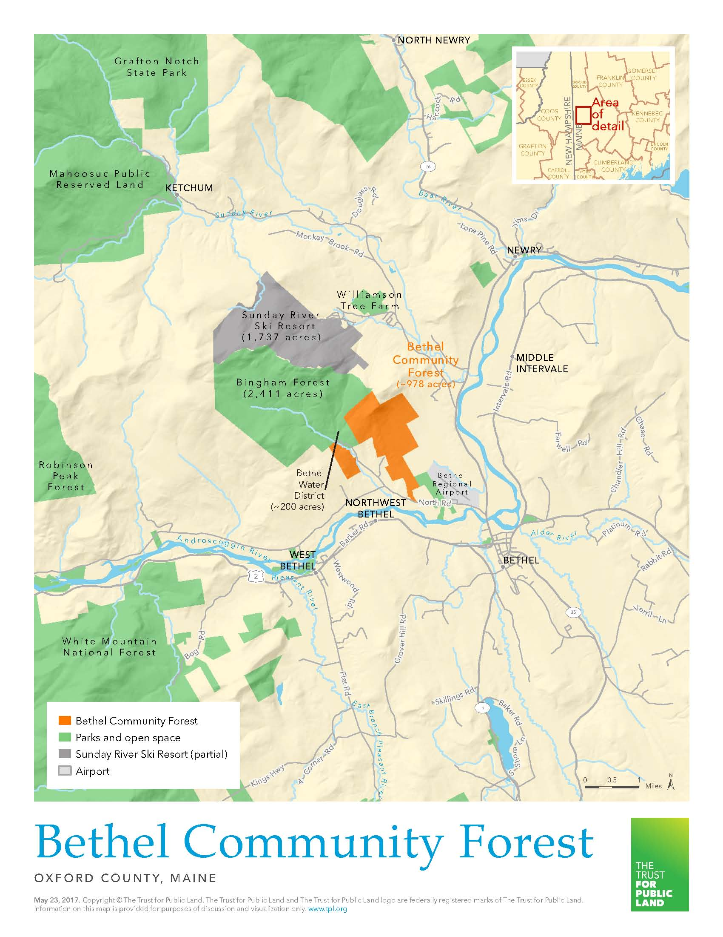
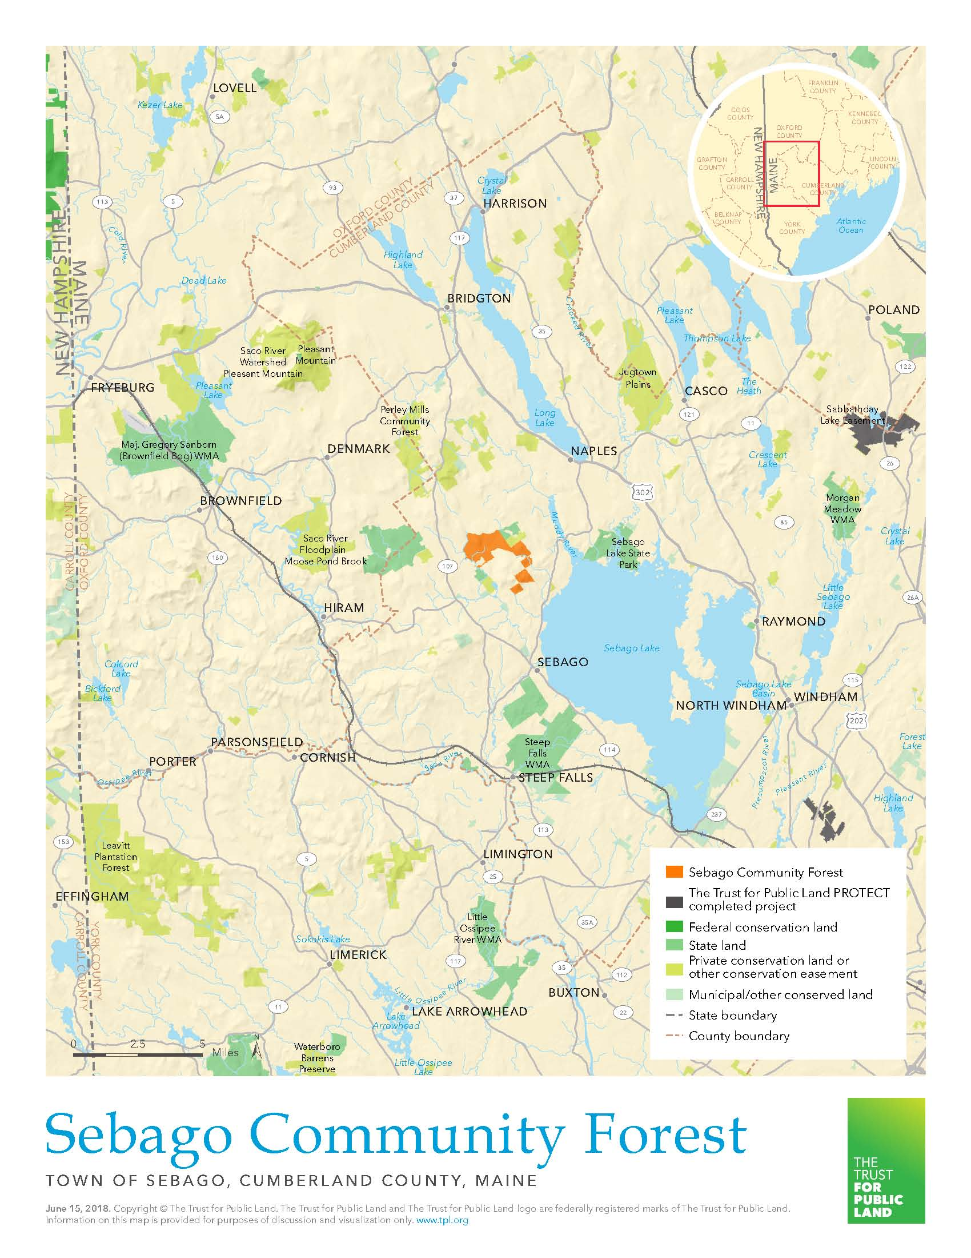
A Tale of Two Water Districts

Slide 20
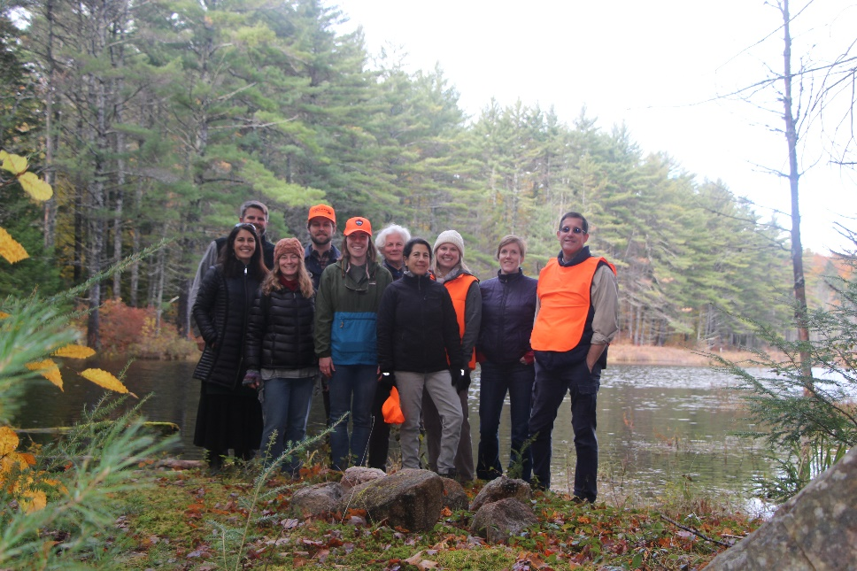
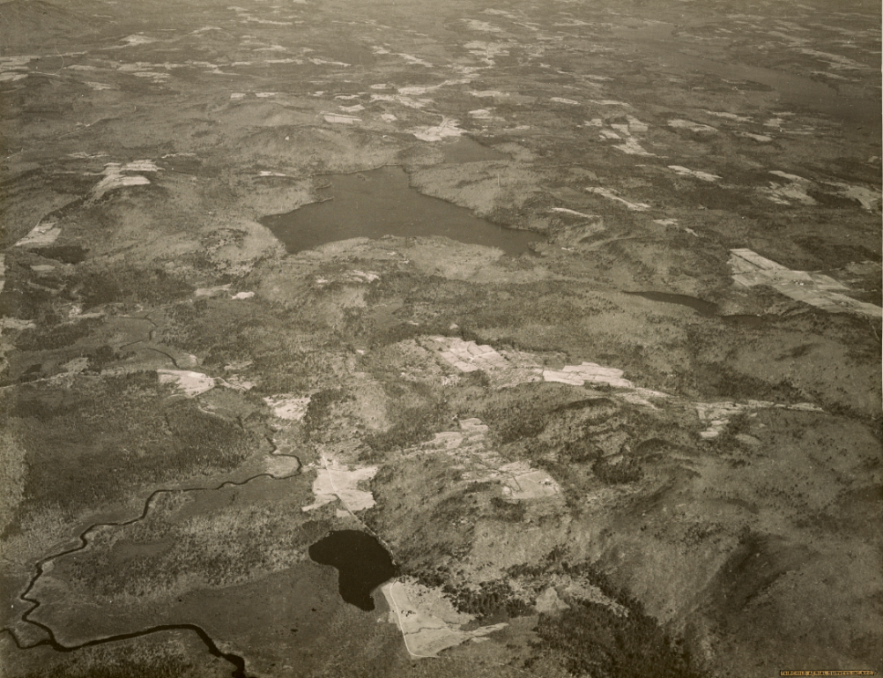
Tiger Hill Community Forest - Sebago
Property Identification
Funding
Credibility
Data/Information
Promotion
Events

Slide 21
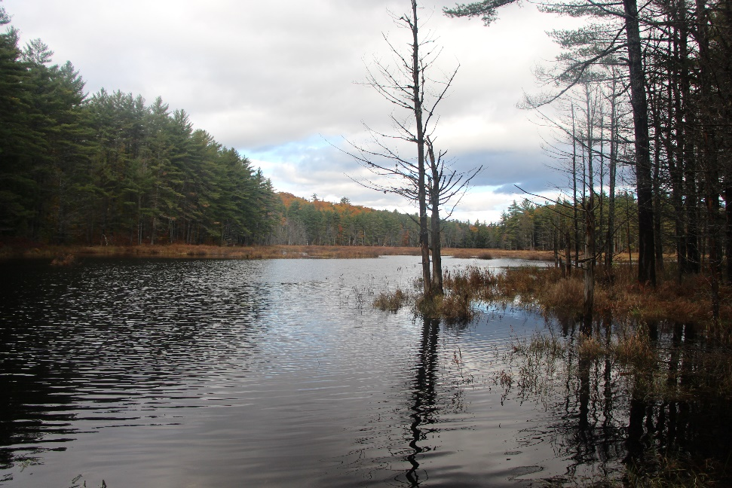
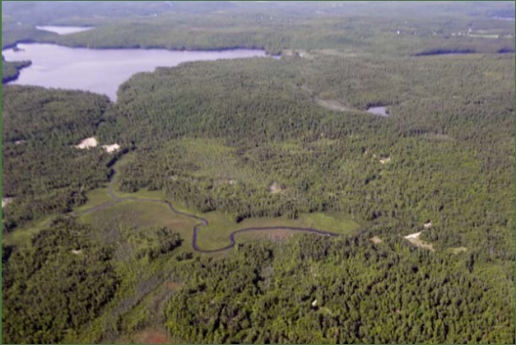
Tiger Hill Community Forest - Sebago
Funding
Portland Water District
MNRCP
Private Foundations
Individuals

Slide 22
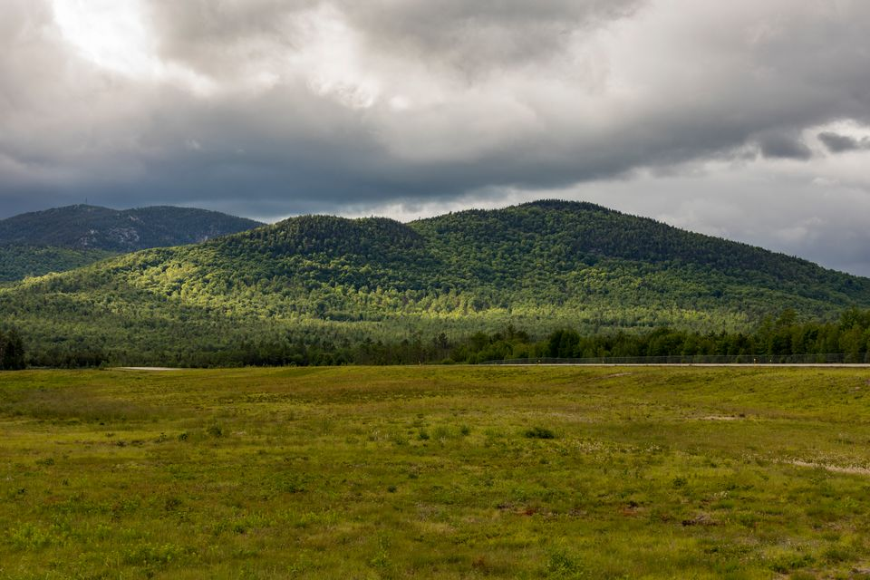
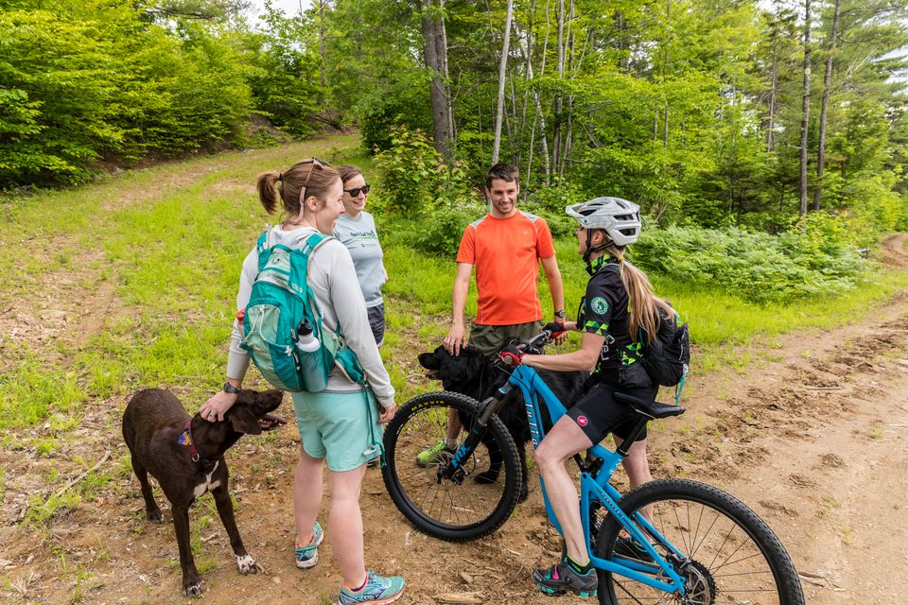
Bethel Community Forest
Landowner
Support Letters
Credibility
Information
Recreation

Slide 23
Bethel Community Forest

Slide 24
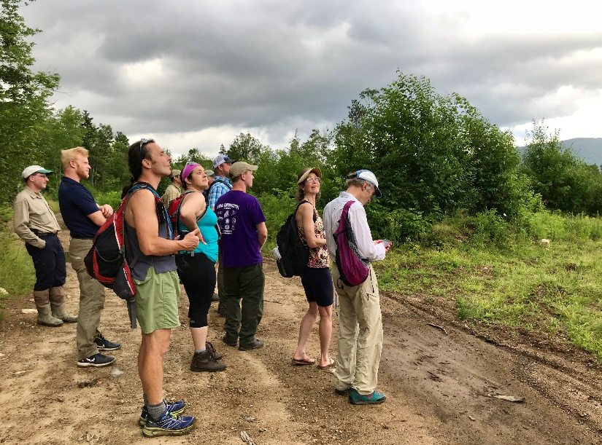
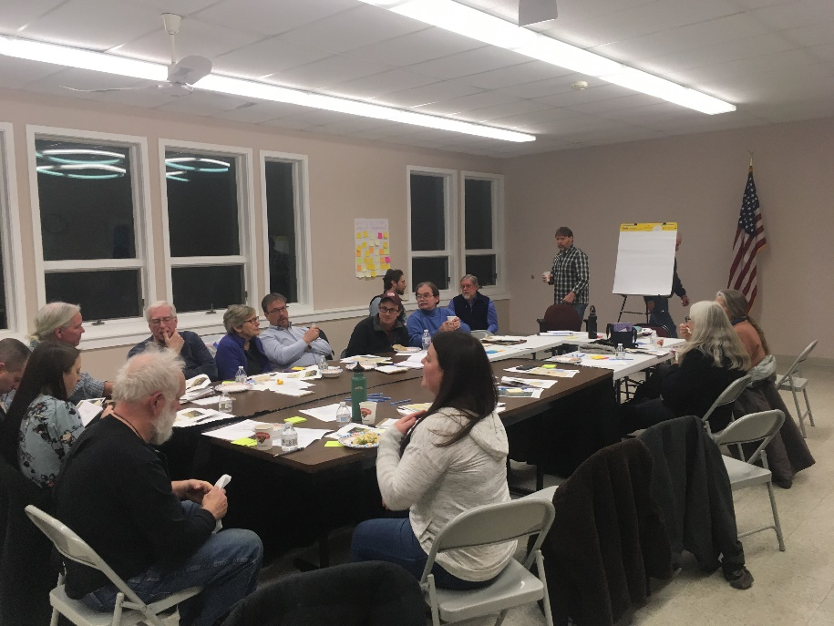
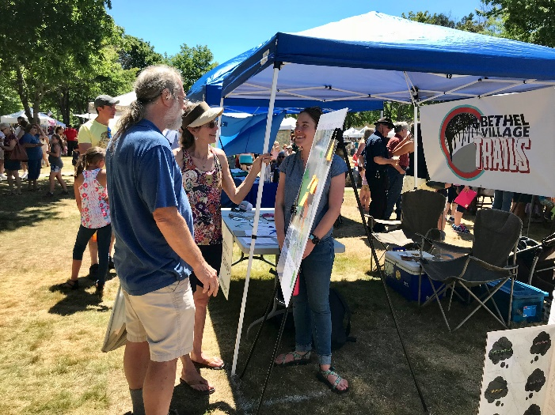
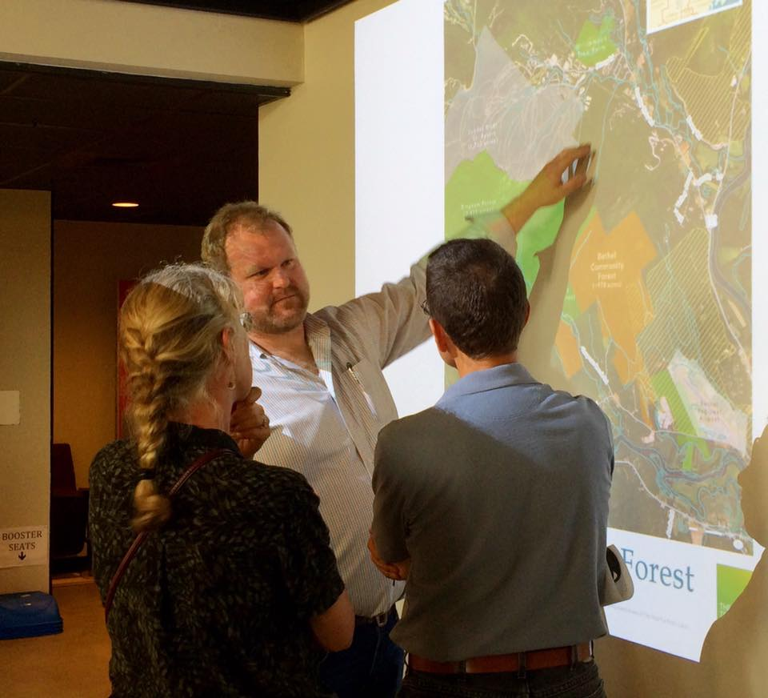
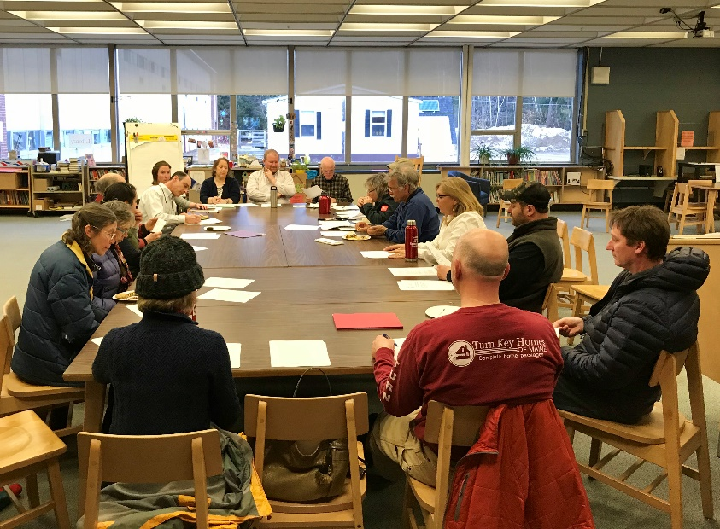
Filling the Well

