Slide 1

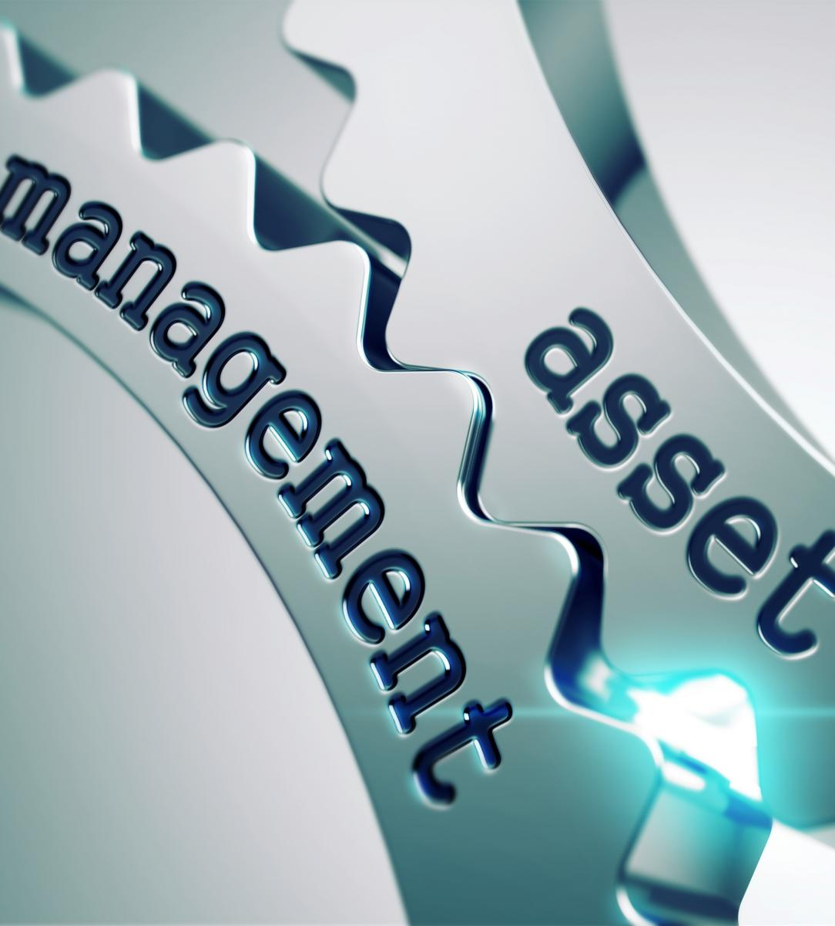
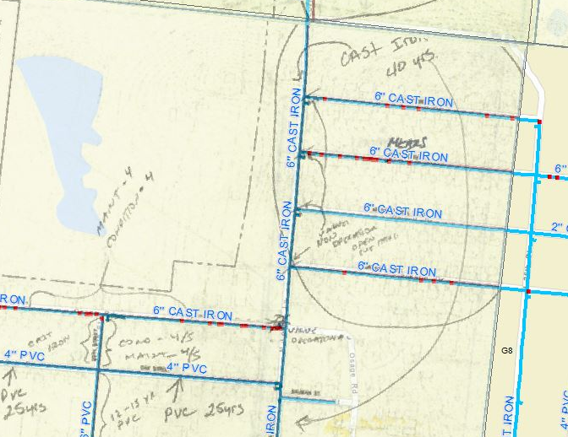
Grant Management Workshop 2
After the Money: Planning, Milestones, and Financials
Presented By: Heather Himmelberger
www.southwestefc.unm.edu
www.efcnetwork.org
This program is made possible under a cooperative agreement with the U.S. EPA.

Slide 2


Today is Part 2 of a Two-Part Series On Grants and Grant/Loan Management
Before the Money
November 8, 2018
After the Money
January 17, 2018

Slide 3

Access Part 1 on the EFCN Website (Either Slides or Recording)
https://efcnetwork.org/events/webinar-grant-writing-101/

Slide 4
Overlap Between Parts 1 and 2
Seeking Funding for Projects
After Funding Has Been Received
Pre-Planning
Planning
Design
These three steps may be either before the money or after

Slide 5
Overlap Between Parts 1 and 2
Seeking Funding for Projects
After Funding Has Been Received
One More Item to Note: We Called this Grant’s Management, But It Applies Equally To Any Kind of Funding: Grants, Loans, Other

Slide 6




After the Funding: Topics We’ll Cover
A Little Bit of Finance
Working with Engineers, Alternatives Evaluation

Slide 7
Let’s Start With Planning

Slide 8
Why Does Planning Matter So Much?
Pre-planning/ Planning
Design
Operation of the Facility
Construction

Slide 9
The Greatest Influence at the Least Cost Occurs at the Earliest Stages – Planning & Pre-Planning

Slide 10
Let’s Look at an Example
$
$$
$$$$
$$$$$$$$$$$
The Planner Indicates the Location of a Storage Tank on the Hill Behind Town
The Engineer Designs the Project With That Tank Location
The Construction Contractor Builds the Tank in That Location
The Operator Realizes That the Tank Location Has Two Problems. The Location is Inaccessible in Bad Weather (Rain or Snow) and the Elevation Means That Another Tank Overflows.
Highest cost
Least Influence

Slide 11
$
$$
$$$$
$$$$$$$$$$$
THE PLANNER INDICATES THE LOCATION OF A STORAGE TANK ON THE HILL BEHIND TOWN
THE ENGINEER DESIGNS THE PROJECT WITH THAT TANK LOCATION
THE CONSTRUCTION CONTRACTOR BUILDS THE TANK IN THAT LOCATION
THE OPERATOR REALIZES THAT THE TANK LOCATION HAS TWO PROBLEMS. THE LOCATION IS INACCESSIBLE IN BAD WEATHER (RAIN OR SNOW) AND THE ELEVATION MEANS THAT ANOTHER TANK OVERFLOWS
We Want to Have Well-Planned Projects To Keep Costs Low, and Projects Functioning Properly After They Are In Operation.

Slide 12
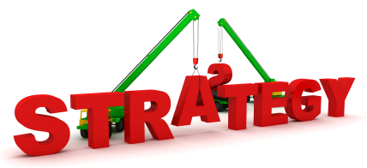
Part of Planning: Understanding Initial Starting Place & Overall Needs
Builds Into a Consideration of How The Assets Will Need to be Managed Into the Future (O&M, Repair, Replacement)

Slide 13
Asset Management is One Type of Planning That Can be Very Helpful With Infrastructure Projects
Asset Management Involves…

Slide 14
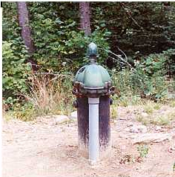
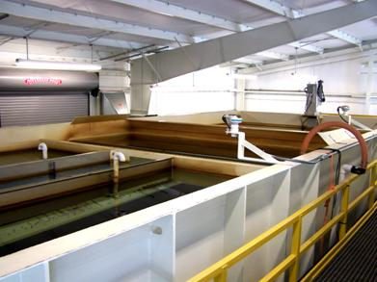
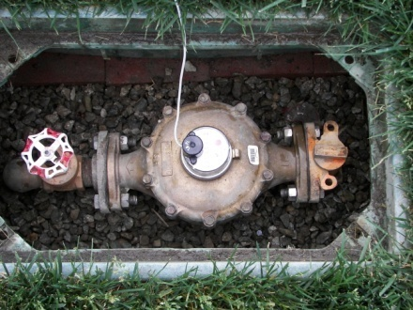
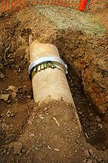
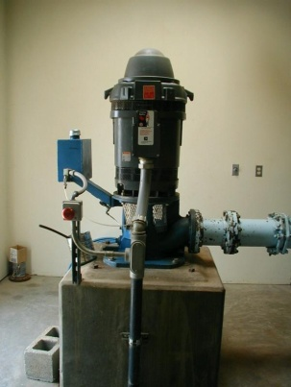
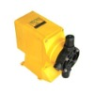
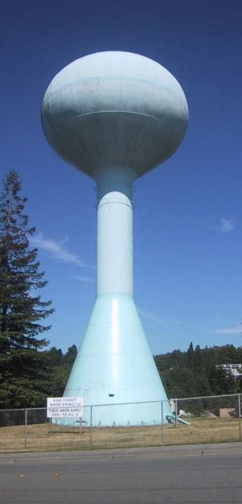
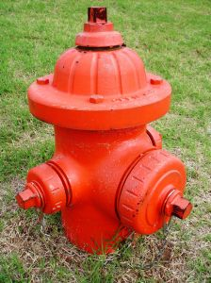
Identifying What Assets You Have
How Many, What Type, Location, Condition, Useful Life Remaining, & Replacement Cost

Slide 15

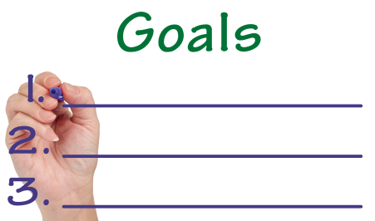

Understanding What You Want Your Assets to Do
How Well Are Your Assets Doing That?
Are You Meeting Customer Expectations?

Slide 16
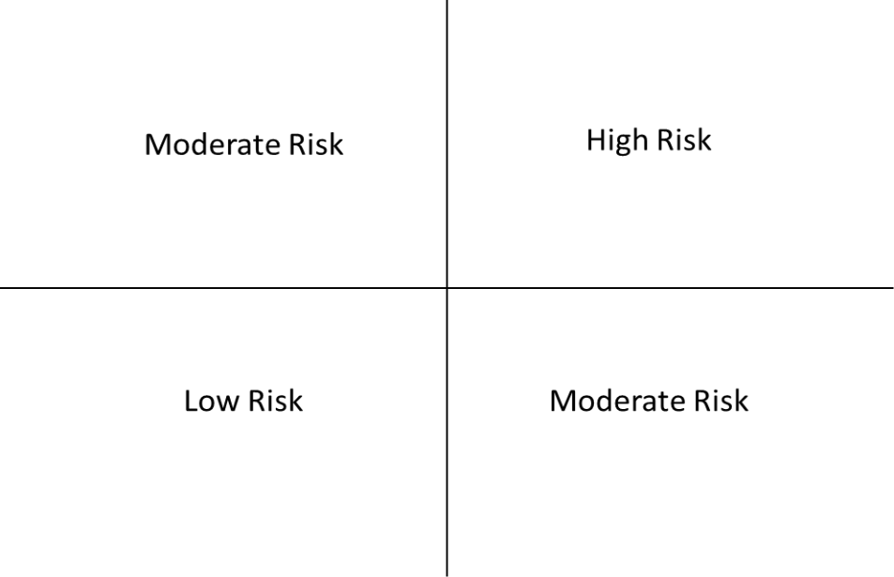
Figuring Out Which Assets Are Critical to Sustained Operations
Which Assets Are Likely to Fail and What Are the Consequences of the Failure?

Slide 17


Thinking About the Assets Over Their Entire Life
When is the Best Time to Intervene? What Interventions Are Possible at Each Stage? What’s the Most Efficient Way to Intervene?

Slide 18


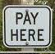
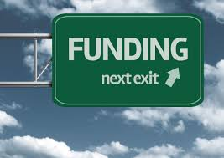
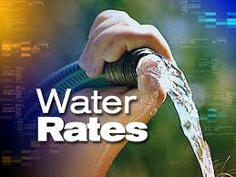

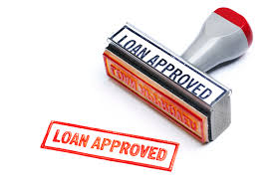
Where does the money come from?
Considering Long-Term Funding for Sustainability
How Much Money Do You Need? Where Will it Come From? What Do You Need Over the Life of the Facility (50 to 100 Years)?
Financial Resources

Slide 19

What Asset Management Activities Can
be Particularly Helpful in This Process?
A Good, Comprehensive Map of Your Assets
An Asset Inventory (A List of All of Your Assets and Their Characteristics)
A Short and Long Term Capital Improvement Plan
An Understanding of the Current O&M Requirements

Slide 20
Another Part of Planning is Asking Questions
Is This the Right Project?
Is This the Right Time to Do the Project?
What are the Risks if I Don’t Take This Project On Right Now?
What are the Benefits if I Do the Project?
Is This Project Being Timed to Correspond to Another Activity (e.g., Road Paving, Expansion)

Slide 21
If the Answer is: Not the Right Project or Not the Right Time For the Project, Stop Here & Re-Evaluate
Remember: This is the Time with the Greatest Influence at the Least Cost

Slide 22
If the Answer is: The Right Project At The Right Time, Move To Design

Slide 23
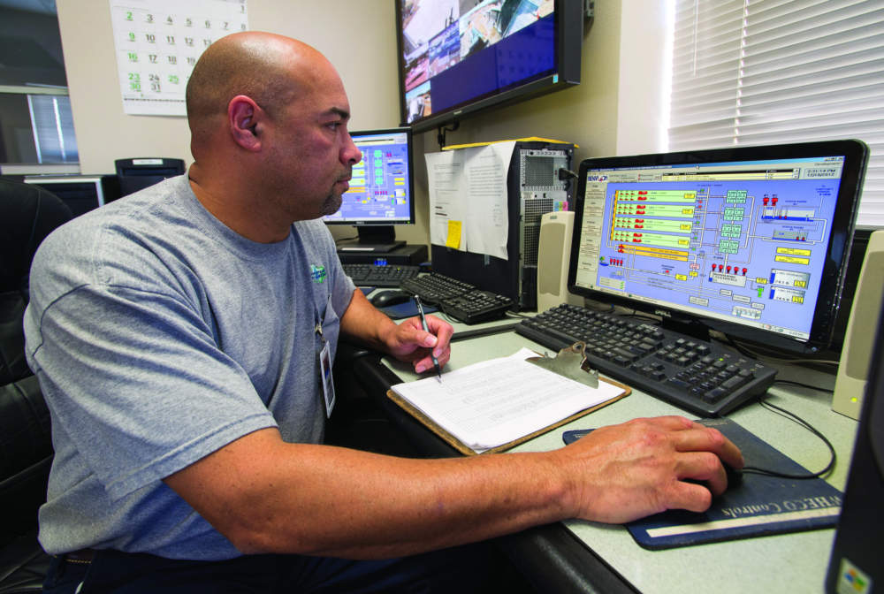
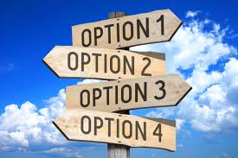
During Design You Will be Working With Engineers: Two Main Considerations for Today
Operations
Alternatives Evaluation

Slide 24
Alternatives Evaluation

Slide 25

Alternatives Evaluation
Questions to Ask:
Are All Viable Alternatives Considered?
Are They All Given Equal Consideration or is the Alternative Pre-Ordained?
Are Water System Personnel Able to Suggest Alternatives?
  If so, are All These Options Given Consideration by the Design Engineer?

Slide 26
Alternatives Evaluation
Questions to Ask:
Are the Long-Term Costs of the Alternatives Taken into Consideration or Just the Initial Costs?
Is Energy Efficiency/Energy Use Considered in the Alternatives Process?
Is Water Efficiency Considered?

Slide 27
Alternatives Evaluation
Questions to Ask:
Are New Technologies Considered or Just Standard Technologies?
If New Technologies are Considered, are You Given Examples of Utilities Using the Technology? Are You Given a Chance to Speak to These Utilities About Their Experiences?

Slide 28
Alternatives Evaluation
Questions to Ask:
What Does the Write Up of the Alternatives Look Like? Are They Written Up as if All Were Considered Equally?
What Does the Costing Portion Look Like? Were All Alternatives Given the Same Level of Costing?

Slide 29
Alternatives Evaluation
A Few Examples:
A Water System Was Given a Reverse Osmosis System When it Was Not Needed
A System Whose Alternative Evaluation Process Ignored Cheaper, Better Alternatives; Had to be Rejected By the SRF Agency During Review

Slide 30
Alternatives Evaluation
Do You Believe Other Alternatives Might Be Better?
Have You Had Any Cases Where A Different Alternative Would Have Been Better?
Consider How This Process Has Worked in the Past:
How Involved Have You Been Able to be?
Do You Feel Like You Get the Best Alternative?

Slide 31
Recall That Intervening During the Design Phase Still Allows You to Exert a Lot of Influence at a Relatively Low Cost. The More Involved You are the Better Chance to Have a Long-Term Impact
Figure 2. Relationship between influence and expenditures over project lifetime²

Slide 32
Even Making a Change at 90% Design Might Be the Best Decision For the Long-Term of the Facility
Figure 2. Relationship between influence and expenditures over project lifetime²

Slide 33

Operations & Design Is An Important Collaboration

Slide 34

Operations & Design Should
Be A Collaborative Relationship
How Involved Are Operations Personnel In Design Discussions? Who is Involved in the Discussions?
What is the Primary Focus of the Discussions?
At What Point in the Process Do They Occur?

Slide 35
If You Do Involve Operations, Do Your Engineers Usually Listen to You?
Do the Engineers Speak
in a Manner You Can
Understand?
If Not, Do You Ask for Them to Explain it in Other Terms?

Slide 36
Remember, You Know the Specifics of the System Better Than Anyone Else
While the Engineer Knows How To Make Something Work, He/She May Not Be Well-Versed in The Operational Implications of the Design

Slide 37

Design and Operations are Inextricably Intertwined: The Best Design Won’t Achieve its Intended Purpose Without Good Operations

Slide 38
Likewise, the Best Operations Will Not Fix a Poor Design

Slide 39
It is Extremely Important to Think Through Operations as an Integral Part of Design
Remember: By Operations, Least Influence at the Highest Cost

Slide 40
Considerations of Operations in Design
What are the Major Activities Required in Routine Operation of Each Asset Included in the Design?
What Maintenance is Required?

Slide 41
Considerations of Operations in Design
What Spare Parts are Required? Where are They Purchased? What is the Cost of the Parts?
What Level of Certification Will Be Required to Operate the New Facility? Is This Different Than the Prior Facility?

Slide 42
Considerations of Operations in Design
What Level of Specialized Training is Required, if Any?
What Number of Operators Will Be Required to Operate the New Facility? Is That Different Than the Existing Facility?

Slide 43
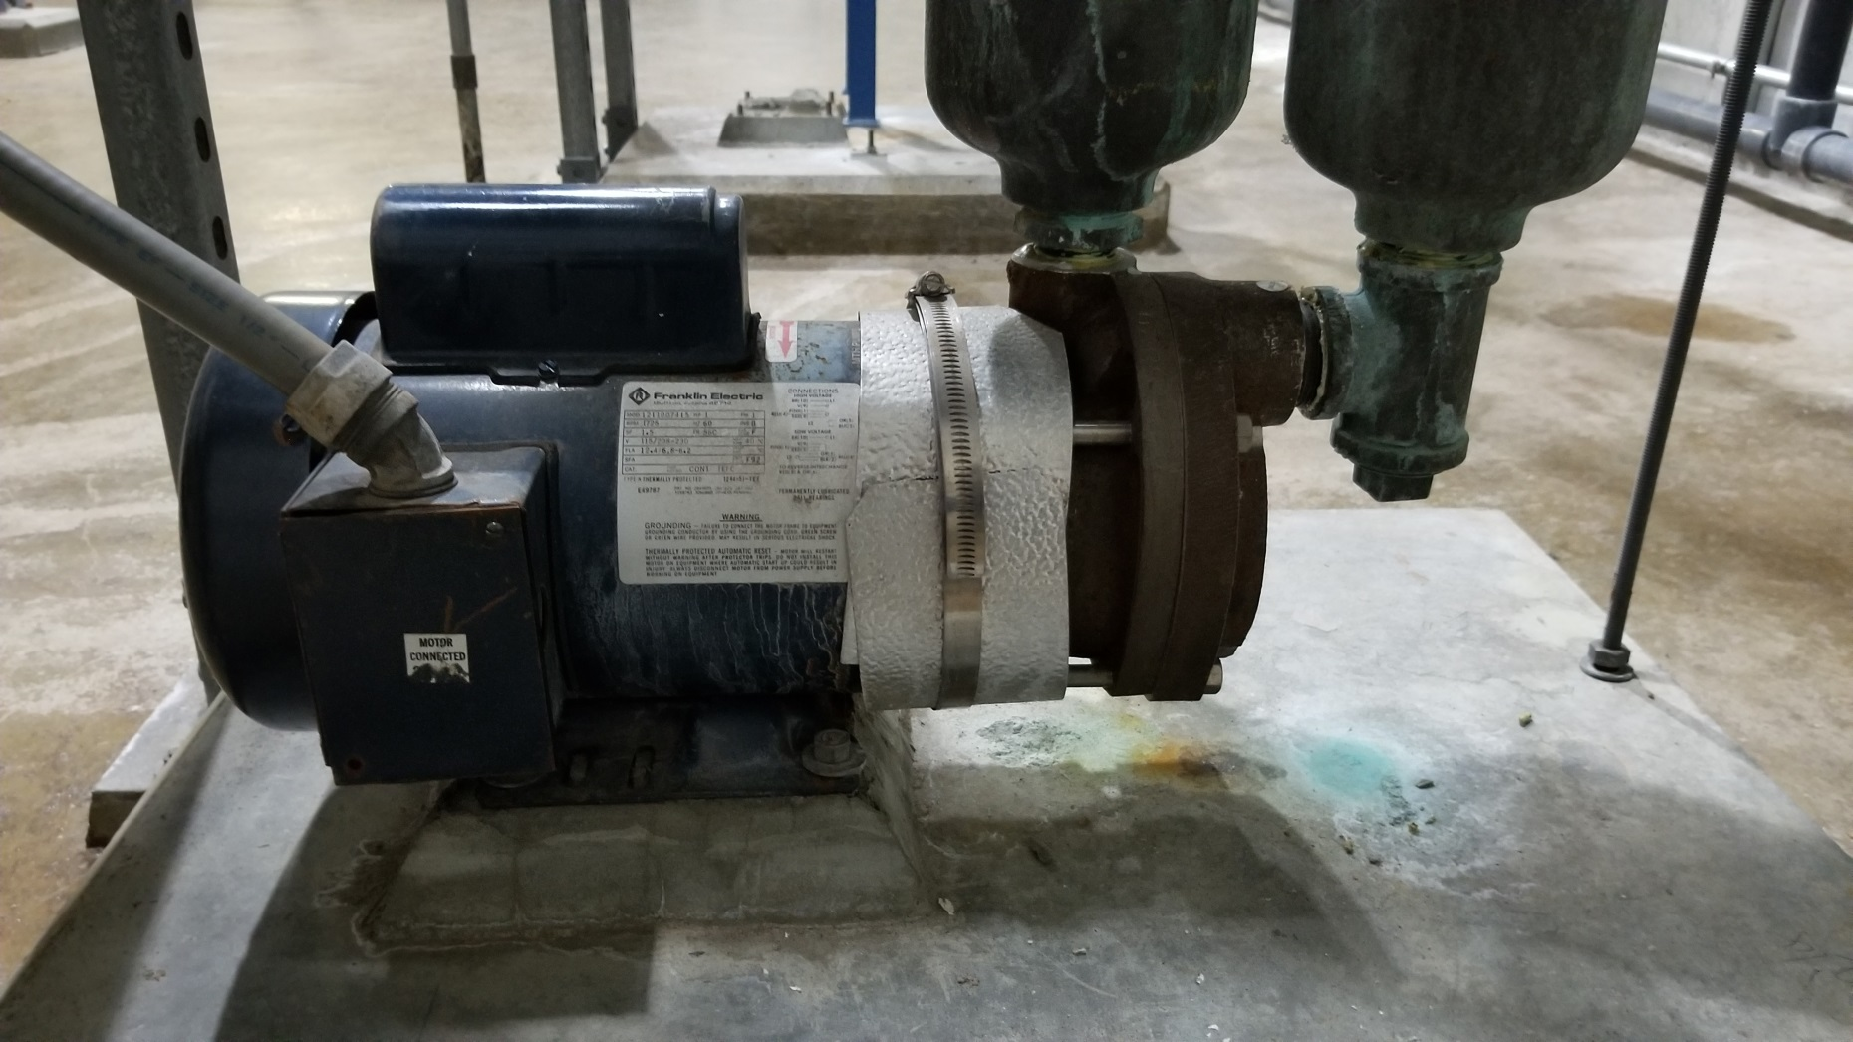
Original Design

Slide 44
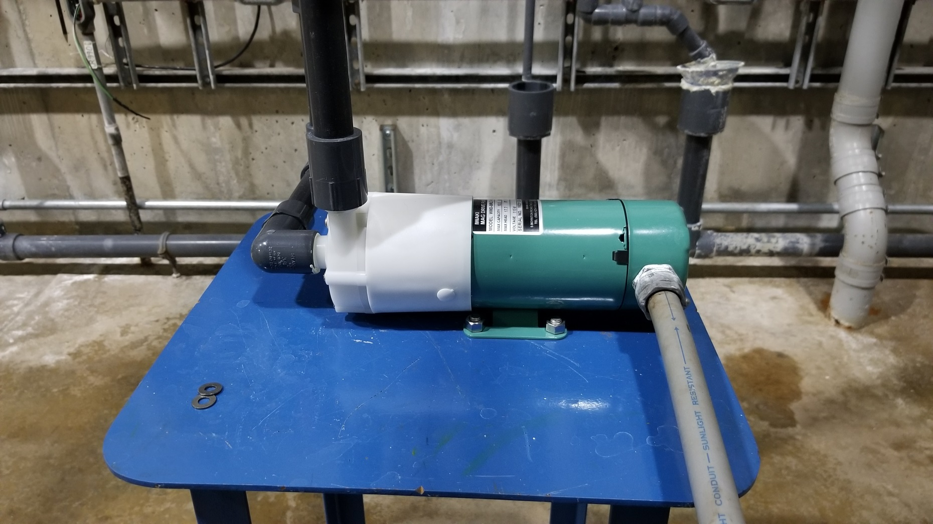
Retrofit After The Fact

Slide 45

Another Example: Change Made During Design
Water Treatment Plant with Glass Control Room

Slide 46

Important to Remember a Whole Project is Capital AND Operations

Slide 47
After the Project is Constructed, You Will Have to Operate It For The Next 25, 50, 75, … Years

Slide 48
Once You Are Ready to Do A Project it is A Good Idea to Set Project Milestones
Milestones are Major and Minor Tasks Along the Way to Completing the Project

Slide 49
First Milestones: The Major Boundaries
Project Initiation
Project Completion

Slide 50
What are the Activities, Outputs, and Outcomes Associated with the Boundary Conditions
Project Initiation
Project Completion

Slide 51


VS

Slide 52
What Is Created
The Numeric Results
Does Not Involve A Consideration of Quality; Considers Quantity

Slide 53
Examples:
The Number of People Served By A Water System
The Number of Gallons of Water Produced
The Number of Miles of Pipe Put in the Ground

Slide 54
The Level of Performance, Achievement, or Quality that Occurred Because of the Activity
An Assessment of the Success of the Process

Slide 55
Examples:
The Increase in the % of People Served By Water Meeting EPA’s Primary Drinking Water Standards
Reduction of a Particular Contaminant in the Drinking Water (e.g., Reduced Arsenic Concentration)

Slide 56
Both Are Needed to Assess the Effectiveness of the Project
Outputs Are Usually Easier to Measure and Faster to Achieve; Outcomes Take Longer to See But May Better Define Success

Slide 57
Building Projects to Achieve Outcomes:
Describe the Outcomes You Are Trying to Achieve with the Project (Why Are You Doing the Project At All?)
Turn the Outcomes You Want to Achieve (Item 1) into Something That Can Be Measured (e.g., % Increase in Customers Served By Compliant Drinking Water or % Increase in Number of Customers Served By a Community Water System)
If You Can’t Answer This Question Effectively, You Shouldn’t Be Doing The Project

Slide 58
Building Projects to Achieve Outcomes:
Confirm That the Outcomes Are Linked to the Outputs and Activities
  (Can You Expect to Achieve the Outcomes Based on What You Are Doing?)
Implement the Measurement of Outcomes and Track Achievement For Funding Agencies, Regulatory Agencies, Elected Leaders and Customers

Slide 59
Determine the Outputs and Outcomes Associated With the Boundary Conditions
Project Initiation
Project Completion
Expected Outputs:___
Expected Outcomes: ___

Slide 60
What Activities Are Needed to Achieve the Expected Outputs, and Outcomes?
Activities Needed to Achieve Expected Outputs and Outcomes
Project Initiation
Project Completion
Expected Outputs: ___
Expected Outcomes: ___

Slide 61
Place Each Major Activity Needed to Achieve Outputs and Outcomes on Milestone Graph
Project Initiation
Major Activity 1
Major Activity 2
Major Activity 3
Major Activity 4
Project Completion
Expected Outputs:___
Expected Outcomes: ___

Slide 62
Are There Minor Activities That Take Place Between the Major Activities? If So, Add Them to the Milestone Graph
Project Initiation
Major Activity 1
Major Activity 2
Major Activity 3
Major Activity 4
Project Completion
Expected Outputs:___
Expected Outcomes: ___
Minor Activity 1
Minor Activity 2
Minor Activity 3
Minor Activity 4
Minor Activity 5
Minor Activity 6

Slide 63
Check Over the Listing of Major and Minor Activities – Will These Activities Be Sufficient to Achieve the Desired Outputs and Outcomes? If Not, Add More
Project Initiation
Major Activity 1
Major Activity 2
Major Activity 3
Major Activity 4
Project Completion
Expected Outputs:___
Expected Outcomes: ___
Minor Activity 1
Minor Activity 2
Minor Activity 3
Minor Activity 4
Minor Activity 5
Minor Activity 6

Slide 64
Once All the Major and Minor Activities Necessary Are Included on the Graph, Add Schedule
Project Initiation
Major Activity 1
Major Activity 2
Major Activity 3
Major Activity 4
Project Completion
Expected Outputs:___
Expected Outcomes: ___
Minor Activity 1
Minor Activity 2
Minor Activity 3
Minor Activity 4
Minor Activity 5
Minor Activity 6

Slide 65
Start with the Project Initiation Date and Anticipated Completion Date
May 2019
Sept 2022
Project Initiation
Major Activity 1
Major Activity 2
Major Activity 3
Major Activity 4
Project Completion
Expected Outputs:___
Expected Outcomes: ___
Minor Activity 1
Minor Activity 2
Minor Activity 3
Minor Activity 4
Minor Activity 5
Minor Activity 6

Slide 66
Work with Engineer & Funder(s) to Fill in the Remaining Dates
May 2019
Mar 2020
Nov 2020
May 2021
Nov 2021
Sept 2022
Oct 2019
Aug 2020
Jan 2021
Sep 2021
Feb 2022
July 2022
Project Initiation
Major Activity 1
Major Activity 2
Major Activity 3
Major Activity 4
Project Completion
Expected Outputs:___
Expected Outcomes: ___
Minor Activity 1
Minor Activity 2
Minor Activity 3
Minor Activity 4
Minor Activity 5
Minor Activity 6

Slide 67
Work w/Engineer & Funder(s) to Fill in the Total Project Cost
May 2019
Mar 2020
Nov 2020
May 2021
Nov 2021
Sept 2022
Oct 2019
Aug 2020
Jan 2021
Sep 2021
Feb 2022
July 2022
Project Completion
Project Initiation
Major Activity 1
Major Activity 2
Major Activity 3
Major Activity 4
Expected Outputs:___
Expected Outcomes: ___
Minor Activity 1
Minor Activity 2
Minor Activity 3
Minor Activity 4
Minor Activity 5
Minor Activity 6
$2.5 M

Slide 68
Work w/Engineer & Funder(s) to Fill in the Rest of the Costs
May 2019
Mar 2020
Nov 2020
May 2021
Nov 2021
Sept 2022
Oct 2019
Aug 2020
Jan 2021
Sep 2021
Feb 2022
July 2022
Project Completion
Project Initiation
Major Activity 1
Major Activity 2
Major Activity 3
Major Activity 4
Expected Outputs:___
Expected Outcomes: ___
Minor Activity 1
Minor Activity 2
Minor Activity 3
Minor Activity 4
Minor Activity 5
Minor Activity 6
$80 K
$85 K
$350 K
$750 K
$150 K
$125 K
$550 K
$90 K
$250 K
$70 K
$2.5 M

Slide 69
Create a Table with Major and Minor Activities (Tasks), including Completion Date and Costs
Task | Expected Completion Date | Anticipated Cost | Anticipated Cumulative Cost
Project Initiation | May 2019
Minor Activity 1 | Oct 2019 | $80,000 | $80,000
Minor Activity 2 | Mar 2020 | $85,000 | $165,000
Major Activity 1 | Aug 2020 | $350,000 | $515,000
Major Activity 2 | Nov 2020 | $750,000 | $1,265,000
Minor Activity 3 | Jan 2021 | $150,000 | $1,415,000
Minor Activity 4 | May 2021 | $125,000 | $1,540,000
Major Activity 3 | Sep 2021 | $550,000 | $2,090,000
Minor Activity 5 | Nov 2021 | $90,000 | $2,180,000
Major Activity 4 | Feb 2022 | $250,000 | $2,430,000
Minor Activity 6 | July 2022 | $70,000 | $2,500,000
Project Completion | Sept 2022 | $2,500,000 | $2,500,000

Slide 70
Create a Table with Major and Minor Activities (Tasks), including Completion Date and Costs
Task | Expected Completion Date | Anticipated Cost | Anticipated Cumulative Cost
Project Initiation | May 2019
Minor Activity 1 | Oct 2019 | $80,000 | $80,000
Minor Activity 2 | Mar 2020 | $85,000 | $165,000
Major Activity 1 | Aug 2020 | $350,000 | $515,000
Major Activity 2 | Nov 2020 | $750,000 | $1,265,000
Minor Activity 3 | Jan 2021 | $150,000 | $1,415,000
Minor Activity 4 | May 2021 | $125,000 | $1,540,000
Major Activity 3 | Sep 2021 | $550,000 | $2,090,000
Minor Activity 5 | Nov 2021 | $90,000 | $2,180,000
Major Activity 4 | Feb 2022 | $250,000 | $2,430,000
Minor Activity 6 | July 2022 | $70,000 | $2,500,000
Project Completion | Sept 2022 | $2,500,000 | $2,500,000
Look At Expenditures – How Are Costs Spread Out Over Time? Are There Long Periods With No Expenditures? Are Costs Higher Up Front, or in the Middle, or at the End?

Slide 71
Create a Table with Major and Minor Activities (Tasks), including Completion Date and Costs
Task | Expected Completion Date | Anticipated Cost | Anticipated Cumulative Cost
Project Initiation | May 2019
Minor Activity 1 | Oct 2019 | $80,000 | $80,000
Minor Activity 2 | Mar 2020 | $85,000 | $165,000
Major Activity 1 | Aug 2020 | $350,000 | $515,000
Major Activity 2 | Nov 2020 | $750,000 | $1,265,000
Minor Activity 3 | Jan 2021 | $150,000 | $1,415,000
Minor Activity 4 | May 2021 | $125,000 | $1,540,000
Major Activity 3 | Sep 2021 | $550,000 | $2,090,000
Minor Activity 5 | Nov 2021 | $90,000 | $2,180,000
Major Activity 4 | Feb 2022 | $250,000 | $2,430,000
Minor Activity 6 | July 2022 | $70,000 | $2,500,000
Project Completion | Sept 2022 | $2,500,000 | $2,500,000
Generally, Costs Should Ramp Up At the Beginning to a Higher Level in the Middle and Then Ramp Down to a Lower Level At the End As the Project Slows Down.

Slide 72
Create a Table with Major and Minor Activities (Tasks), including Completion Date and Costs
Task | Expected Completion Date | Anticipated Cost | Anticipated Cumulative Cost
Project Initiation | May 2019
Minor Activity 1 | Oct 2019 | $80,000 | $80,000
Minor Activity 2 | Mar 2020 | $85,000 | $165,000
Major Activity 1 | Aug 2020 | $350,000 | $515,000
Major Activity 2 | Nov 2020 | $750,000 | $1,265,000
Minor Activity 3 | Jan 2021 | $150,000 | $1,415,000
Minor Activity 4 | May 2021 | $125,000 | $1,540,000
Major Activity 3 | Sep 2021 | $550,000 | $2,090,000
Minor Activity 5 | Nov 2021 | $90,000 | $2,180,000
Major Activity 4 | Feb 2022 | $250,000 | $2,430,000
Minor Activity 6 | July 2022 | $70,000 | $2,500,000
Project Completion | Sept 2022 | $2,500,000 | $2,500,000
If There Are Long Periods With No Expenditures Anticipated, Consider Adding Minor Tasks To Spread Out Expenditures

Slide 73
During the Project, Check Actual Activities, Schedules, and Expenditures Against the Planned Ones

Slide 74
July 2019
Dec 2019
Look For Places Where Actuals Don’t Match Anticipated
Mar 2021
Nov 2021
Jan 2022
Apr 2022
Sep 2022
Nov 2022
Apr 2020
Oct 2020
Jan 2021
Jun 2021
May 2019
Mar 2020
Nov 2020
May 2021
Nov 2021
July 2022
Sept 2022
Oct 2019
Aug 2020
Jan 2021
Sep 2021
Feb 2022
Project Initiation
Major Activity 1
Major Activity 2
Major Activity 3
Major Activity 4
Project Completion
Expected Outputs:___
Expected Outcomes: ___
Minor Activity 1
Minor Activity 2
Minor Activity 3
Minor Activity 4
Minor Activity 5
Minor Activity 6
$80 K
$85 K
$350 K
$750 K
$150 K
$125 K
$550 K
$90 K
$250 K
$70 K
$2.5 M

Slide 75
July 2019
Dec 2019
Look for Places Where Actuals Don’t Match Anticipated
Mar 2021
Nov 2021
Jan 2022
Apr 2022
Sep 2022
Nov 2022
Apr 2020
Oct 2020
Jan 2021
Jun 2021
May 2019
Mar 2020
Nov 2020
May 2021
Nov 2021
July 2022
Sept 2022
Oct 2019
Aug 2020
Jan 2021
Sep 2021
Feb 2022
What Caused the Project to Go Off Schedule? Is There Any Way to Get the Project Back On Schedule?
Will the Slip in the Project Schedule Cause a Change in Costs? If So, How?
Will the Slippage in the Schedule Cause a Problem With Regulatory Compliance?
Project Initiation
Major Activity 1
Major Activity 2
Major Activity 3
Major Activity 4
Project Completion
Expected Outputs:___
Expected Outcomes: ___
Minor Activity 1
Minor Activity 2
Minor Activity 3
Minor Activity 4
Minor Activity 5
Minor Activity 6
$80 K
$85 K
$350 K
$750 K
$150 K
$125 K
$550 K
$90 K
$250 K
$70 K
$2.5 M

Slide 76
Track Actual Costs Against Anticipated Costs
Task | Anticipated Cost | Actual Cost | Difference (Over or Under Budget)
Project Initiation
Minor Activity 1 | $80,000 | $90,000 | $10,000
Minor Activity 2 | $85,000 | $120,000 | $35,000
Major Activity 1 | $350,000 | $425,000 | $75,000
Major Activity 2 | $750,000 | $750,000 | $0
Minor Activity 3 | $150,000 | $175,000 | $25,000
Minor Activity 4 | $125,000 | $140,000 | $15,000
Major Activity 3 | $550,000 | $550,000 | $0
Minor Activity 5 | $90,000 | $100,000 | $10,000
Major Activity 4 | $250,000 | $250,000 | $0
Minor Activity 6 | $70,000 | $150,000 | $80,000
Project Completion | $2,500,000 | $2,750,000 | $250,000

Slide 77
Track Actual Costs Against Anticipated Costs
Task | Anticipated Cost | Actual Cost | Difference (Over or Under Budget)
Project Initiation
Minor Activity 1 | $80,000 | $90,000 | $10,000
Minor Activity 2 | $85,000 | $120,000 | $35,000
Major Activity 1 | $350,000 | $425,000 | $75,000
Major Activity 2 | $750,000 | $750,000 | $0
Minor Activity 3 | $150,000 | $175,000 | $25,000
Minor Activity 4 | $125,000 | $140,000 | $15,000
Major Activity 3 | $550,000 | $550,000 | $0
Minor Activity 5 | $90,000 | $100,000 | $10,000
Major Activity 4 | $250,000 | $250,000 | $0
Minor Activity 6 | $70,000 | $150,000 | $80,000
Project Completion | $2,500,000 | $2,750,000 | $250,000
If the Expenses Are Over Anticipated Costs, What Are the Reasons for the Over-expenditure? Is There Any Way to Get the Project Back on Track?
Is There an Impact On the Ability to Get the Project Completed At All? How Are Over-Expenditures Addressed?

Slide 78
Track Actual Costs Against Anticipated Costs
Task | Anticipated Cost | Actual Cost | Difference (Over or Under Budget)
Project Initiation
Minor Activity 1 | $80,000 | $90,000 | $10,000
Minor Activity 2 | $85,000 | $120,000 | $35,000
Major Activity 1 | $350,000 | $425,000 | $75,000
Major Activity 2 | $750,000 | $750,000 | $0
Minor Activity 3 | $150,000 | $175,000 | $25,000
Minor Activity 4 | $125,000 | $140,000 | $15,000
Major Activity 3 | $550,000 | $550,000 | $0
Minor Activity 5 | $90,000 | $100,000 | $10,000
Major Activity 4 | $250,000 | $250,000 | $0
Minor Activity 6 | $70,000 | $150,000 | $80,000
Project Completion | $2,500,000 | $2,750,000 | $250,000
If Expenses Are Less Than Anticipated, What Can Be Done With the Extra Funds? Can Additional Work Be Done or Will the Money Be Returned?

Slide 79
During the Project, Consider Whether the Anticipated Outputs and Outcomes Are Being Achieved

Slide 80
Is the Project Able to Meet the Desired Outputs and Outcomes? If No, Which Ones Won’t Be Achieved and What Will Be Done About It?

Slide 81
If yes, Measure the Ability to Meet the Outcomes and Measure the Outputs

Slide 82
Consider If Problems With the Budget or Schedule Have Impacted the Ability to Meet Project Outputs and Outcomes

Slide 83


Financial Fundamentals
Finally, We’ll Talk a Little About Finance:
Accounting, Bookkeeping, Reporting
PRESENTED BY HEATHER HIMMELBERGER, P.E. Director, SW EFC

Slide 84
Input
Output
Accounting Encompasses the Broader Responsibilities Over Developing and Maintaining the Financial Systems Under Which Bookkeeping and Reporting Functions Are Preformed

Slide 85
Input
Output
Accounting is Concerned With Timely and Accurate Recording of Transactions, Providing Useful Information, for Management and Properly Reporting Such Information for Various People’s Needs, Including Funders.

Slide 86
Input
Output
Goals of Bookkeeping:
  Keep Track of Income and Expenses, Thereby Improving the Organization’s Ability to Ensure More Money Comes in Than Goes Out (Revenue > Expenses)
  Collect the Necessary Financial Information to File Required Reports

Slide 87
Input
Output
Bookkeeping Refers to the Actual Transactional Entering and Recording of Data. Examples Include: Writing Checks, Processing Payroll, Making Deposits, Recording Disbursements and Recording Receipts

Slide 88
Input
Output
Reporting: The Output of the Data Generated Through Various Bookkeeping Entries Is Used for Both Internal and External Purposes. Internal Reports Are Used Within the Organization By Management and Other Personnel. External Reporting Can Be Used By Individuals Outside the Organization.

Slide 89
The Financial Process
1. Identify and Record Transactions
2. Reconcile and Analyze Accounts
3. Summarize into Monthly or Quarterly Report
4. Year End Audit
5. Repeat

Slide 90

Cost Sharing and Matching
The Portion of the Project That A Recipient Contributes Towards the Project
May Be Required To Be Cash or Sometimes In-kind Is Allowed
May Be Voluntary or Mandatory

Slide 91
Cost Sharing and Matching Paperwork
Must Be Documented
Must Be Documented in the Same Manner As Other Costs
Paperwork Supporting In-kind Must Be Kept

Slide 92
Progress Reports
Just About Every (If Not Every) EPA Project of Any Type Has Requirements for Progress Reporting, Many Other Agencies Do As Well
Monthly, Quarterly, Semi-annually or Annual
Check To See What the Requirement Is for Your Grant And What The Due Date Is (Usually 30 Days following The End of The Reporting Period)
Establish A Means of Alerting You That A Report Is Due

Slide 93
Progress Reports
Try To Develop An Easy Way To Complete the Report
Don’t Wait Too Long To Do the Documentation
For Example, Have A Set Place To Write Down Any Significant Item That You Completed in the Week or Month
Have A Set Format (Standardized Is Easier To Follow And Recreate).

Slide 94

Spending Grant Funds
Comply With Internal & External Regulations, Policies, and Procedures
Consider Audit Readiness for Every Transaction
Review Expenditures vs Budget on Every Transaction
No Supplanting or Cost-shifting

Slide 95
Spending Grant Funds
How Do You Become Aware of the Specific Requirements of the Grant?
Do You Have A Checklist or Any Other Process to Keep Abreast of the Requirements and Your Particular Role in Complying With Them?

Slide 96

Documentation
Keep Everything With a Signature
Store in a Safe Place, Both Electronic and Paper Records
Have Back Ups (Both Electronic and Paper) in Multiple Places
Document Everything
Save All Documents
Keep All Documents Pertaining to a Single Project Together

Slide 97

There Are Regulations That Govern How Grants Are Managed, How Payments Are Made, When Payments Are Made, and Many Other Things. Know the Regulations BEFORE the Projects Starts.

Slide 98
Every Grant or Loan Has Specific Reporting Requirements That Should Be Understood and Followed

Slide 99
In Summary…

Slide 100



Slide 101

CONTACT INFORMATION
Heather Himmelberger: heatherh@unm.edu
Dawn Nall: dnall@unm.edu
James Markham: jmarkham@unm.edu
Department of Civil Engineering MSC01 1070
1 University of New Mexico, Albuquerque, NM 87131
505-277-0644
swefc@unm.edu
http://southwestefc.unm.edu

