Slide 1
Group Exercise: Assess the condition and criticality of the following assets
Based on description of the asset, give your opinion on its condition, thinking about how likely/soon the asset might fail
  Horizontal axis. 1 = very low ☺, 5 = very high ☹
Give your opinion on its importance, thinking about consequence or cost if failure occurs
  Vertical axis. 1 = very low ☺, 5 = very high ☹

Slide 2
Asset 1: Elevated Storage Tank
The only storage tank in small groundwater system.
Installed in 1985. Inspected, sand blasted and repainted in 2002.
Annual visual inspection shows no observable problems. No structural issues noted.
Don’t know how long it will last.
Many customers complaining of low pressure.
Possible to pump water directly to customers but would have problems meeting peak demands and will have no fire flow
Source: A.M. KAN Work!

Slide 3
Asset 2: Well Pump #1
1 of 2 well pumps. Each can supply entire system, but system uses this pump more frequently (the second pump is less reliable).
Pump located in the well.
Installed in 1992. No major rehab work since then.
Manufacturer expects pump to last 25 years.
Operating within design specifications but is not as efficient as it used to be. Operator not noticing any other visible or audible problems. Routine maintenance is being performed.
Source: A.M. KAN Work!

Slide 4
Asset 3: Water Main on Elm St.
Main serving half of the system’s customers.
No record of when it was installed. Homes in that area were built in the 1950s.
Operator and owner cannot recall any major rehab or replacement work since they took over in the 1990s.
Had 5 breaks in the past 2 years, and numerous leaks.

Slide 5
Asset 4: Your Choice!
Pick any asset from YOUR water system. Describe it to the group and decide on an appropriate condition and criticality score.

Slide 6
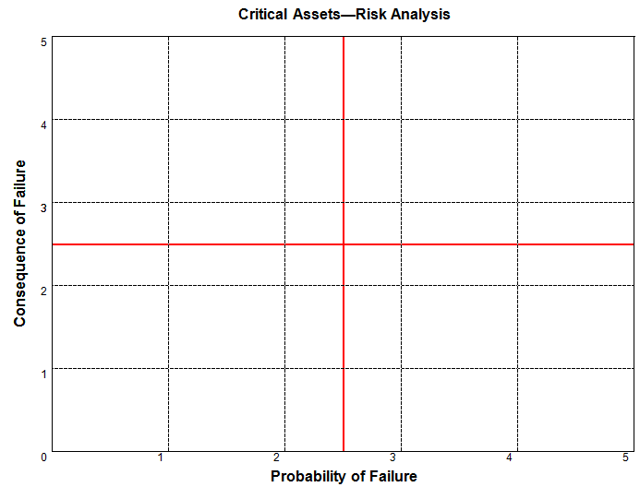
Results from Cullowhee, NC: 6/2015
High
3
1
1
1
3
1
3
1
3
2
4
4
2
4
4
1
2
3
4
2
3
4
4
2
3
1
2
2
Low
High
Source: A.M. KAN Work!

Slide 7
Place the assets on the risk analysis chart
High
3
3
2
3
4
1
4
1
2
3
4
4
1
2
3
4
2
3
4
4
1
2
3
1
2
1
2
1
Low
High
Source: A.M. KAN Work!

Slide 8
Risk of Failure Should Drive the Program
High
Aggressive Monitoring Program
Immediate
Work
Regular Monitoring
Schedule for Rehab/ Replacement
Low
High
Source: A.M. KAN Work!

