Slide 1




Jobs For America’s Graduates
Water Workforce Classroom Presentation
Notes:
Introduction: Talk about yourself! Tell them what you do and maybe a fun fact!

Slide 2

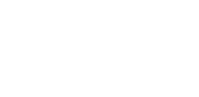
Welcome and Introductions
Grade
Name
What kind of careers are you looking into?
Notes:
Let’s get to know each other! I will start…
Introduce your name
Where you work
Work experience
Funny fact or something random like favorite movie
We will just go around the room and everyone take a minute to tell us what grade you are in, your name and what you plant to do after graduation

Slide 3
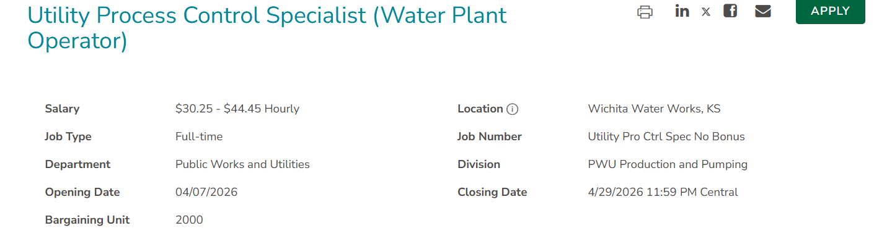
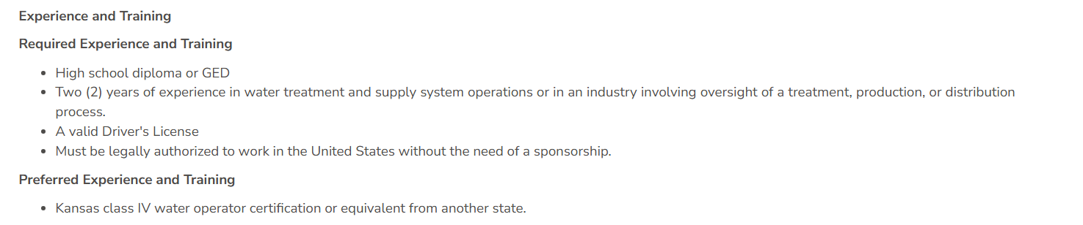
www.efcnetwork.org
This program is made possible under a cooperative agreement with US EPA.
Notes:
(Start off the presentation with an example of a current job opening. This one is from Spring of 2026.)
(Update with a new example as needed. )
Is there anything that stands out to you?
Maybe the pay rate?
Job experience?
A lot of students can get on the job training and with a couple years experience they would qualify for this kind of job.
Keep this in the back of their minds as you talk about water and wastewater workforce.

Slide 4
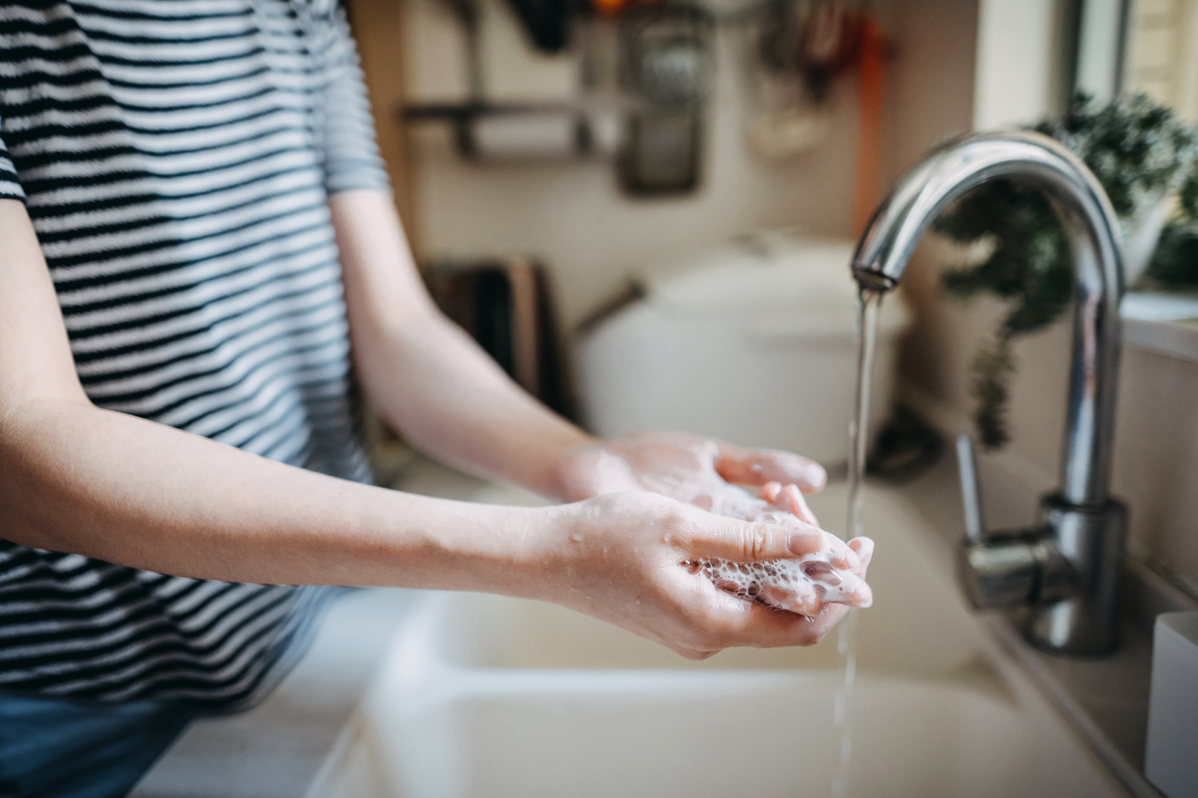
Where does your water come from?
Notes:
Where does your water come from? How does it get to your house, school, or your job?
***ACTIVITY Ask for any volunteers to come and draw a picture of how they get clean water at their house. You could also have each student take a minute to draw out a picture of this on a piece of paper.)

Slide 5
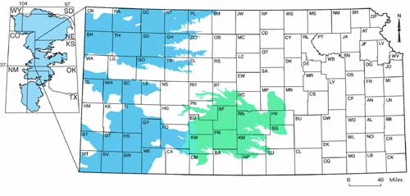
Notes:
(Presenter: Add a map of the state and point out where you are and what is your main source of water)
Help the students understand how important each source of water is. This map of Kansas shows the Ogallala Aquifer in blue and the High Plains Aquifer in green.

Slide 6
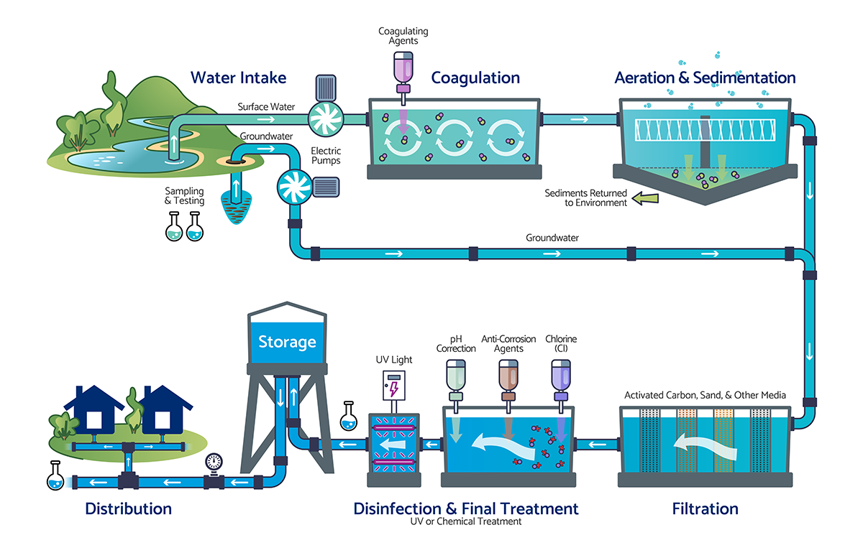
Notes:
*** DRINKING WATER ACTIVITY
Water is treated using 4 steps. And we are going to “act out those steps with our “Lake Water.”
Materials:
Bring a gallon of “dirty water”, students love it if you bring water from a pond or random source
Styrofoam cups
Clear plastic cups
Alum seasoning ( aluminum sulfate)
Popsicle stick or coffee straw to mix in the alum
Crushed charcoal- to show coal filtration
Sand
Pebbles
Papertowels
Pushpins to poke small holes in the Styrofoam cup
Yellow food coloring to represent chlorine
Give each group of students a cup with the lake water, a styrofoam cup, and another clear plastic cup.
First, the water is pumped from the reservoirs to the treatment plant where a chemical like alum (aluminum sulfate) is added to it to make the dirt and particles stick together to make big heavy particles. The water is mixed in large holding tanks with a “propeller” type mixing device. This is called coagulation and flocculation, which is a fancy way of saying “stick together and make bigger pieces. “
2. Sprinkle 1/8 tsp. alum over the surface of the water. The soil particles will stick together and form “floc” this is called flocation or coagulation.
Next the water is allowed to settle the heavy particles to the bottom of the sedimentation tank, while the clarified (clear) water flows off the top to the next step. This second step is called sedimentation.
3. Let samples sit for 5-ish minutes – sedimentation- explain this portion and ask if there are any questions
The third step is called filtration and leads the water through filters made of materials with varying densities and pore space. Filters are made of anthracite coal on top, followed by fine, medium, coarse sand, and finally gravel on the bottom. Walk around the room to show the filter samples while talking. The water filters trap any remaining suspended solids such as particles including clays and silts, natural organic matter, precipitates from the alum, iron and manganese, and microorganisms. The filters get cleaned about every other day because they get full of particles.
4. Poke 10 small holes in the bottom of a Styrofoam cup
Place a small piece of paper towel in the bottom of the cup to act as a filter. Next, add a layer of sand then a layer of gravel. Pour the water through the filter and catch the water that comes through with the other clear cup.
The final step in our water treatment process is disinfection. Chlorine is added to the water to kill any remaining harmful microbes, and then it is stored in water storage tanks from where it travels to your house through pipes underground.
6. Add a drop of yellow food coloring to represent chlorine.

Slide 7

Where does the water go when you flush the toilet, shower, or wash your hands?
Notes:
***ACTIVITY Let’s play a game called to flush or not to flush!
Materials:
Two mason jars
Toilet paper
“flushable” wipe
2 cups water
Place two jars and their lids on a table.
Pour 1 cup of water in each jar.
Add a couple squares of toilet paper to one jar and a flushable wipe to the other jar
Put the lids on the jar and have the students shake each jar.
Allow the jars to sit and ask them what they notice about the toilet paper vs. the wipe…
You can refer to the jars over the course of the presentation- see how they compare.

Slide 8
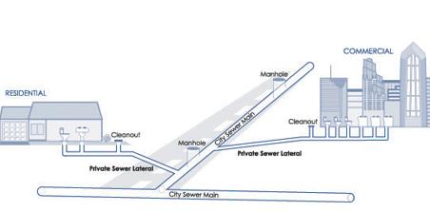
Your home sewer plumbing
Waste Water Treatment
Notes:
Wastewater flows from your house through pipes in your yard, to the city’s sewer main where it is combined with all your neighbor's wastewater and is taken to the wastewater treatment plant.

Slide 9
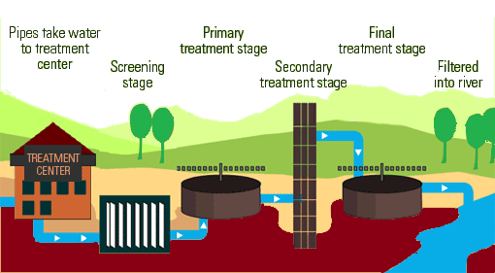
Waste Water Treatment
Notes:
Describe the different stages for a wastewater treatment plant.

Slide 10
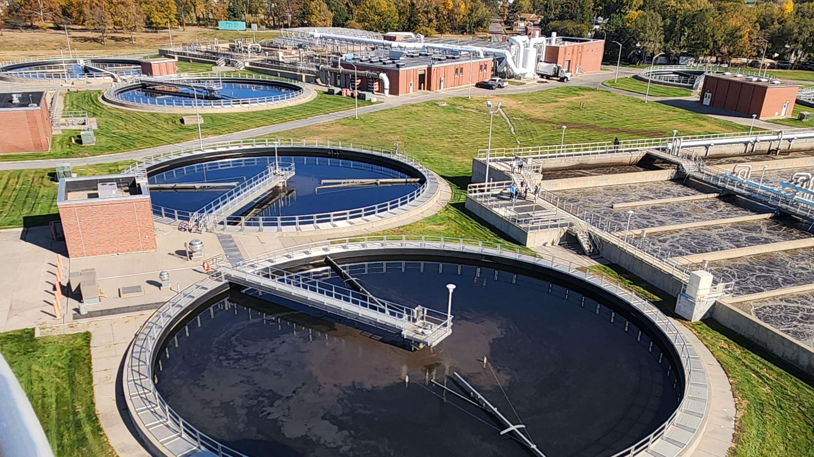
Waste Water Treatment

Slide 11
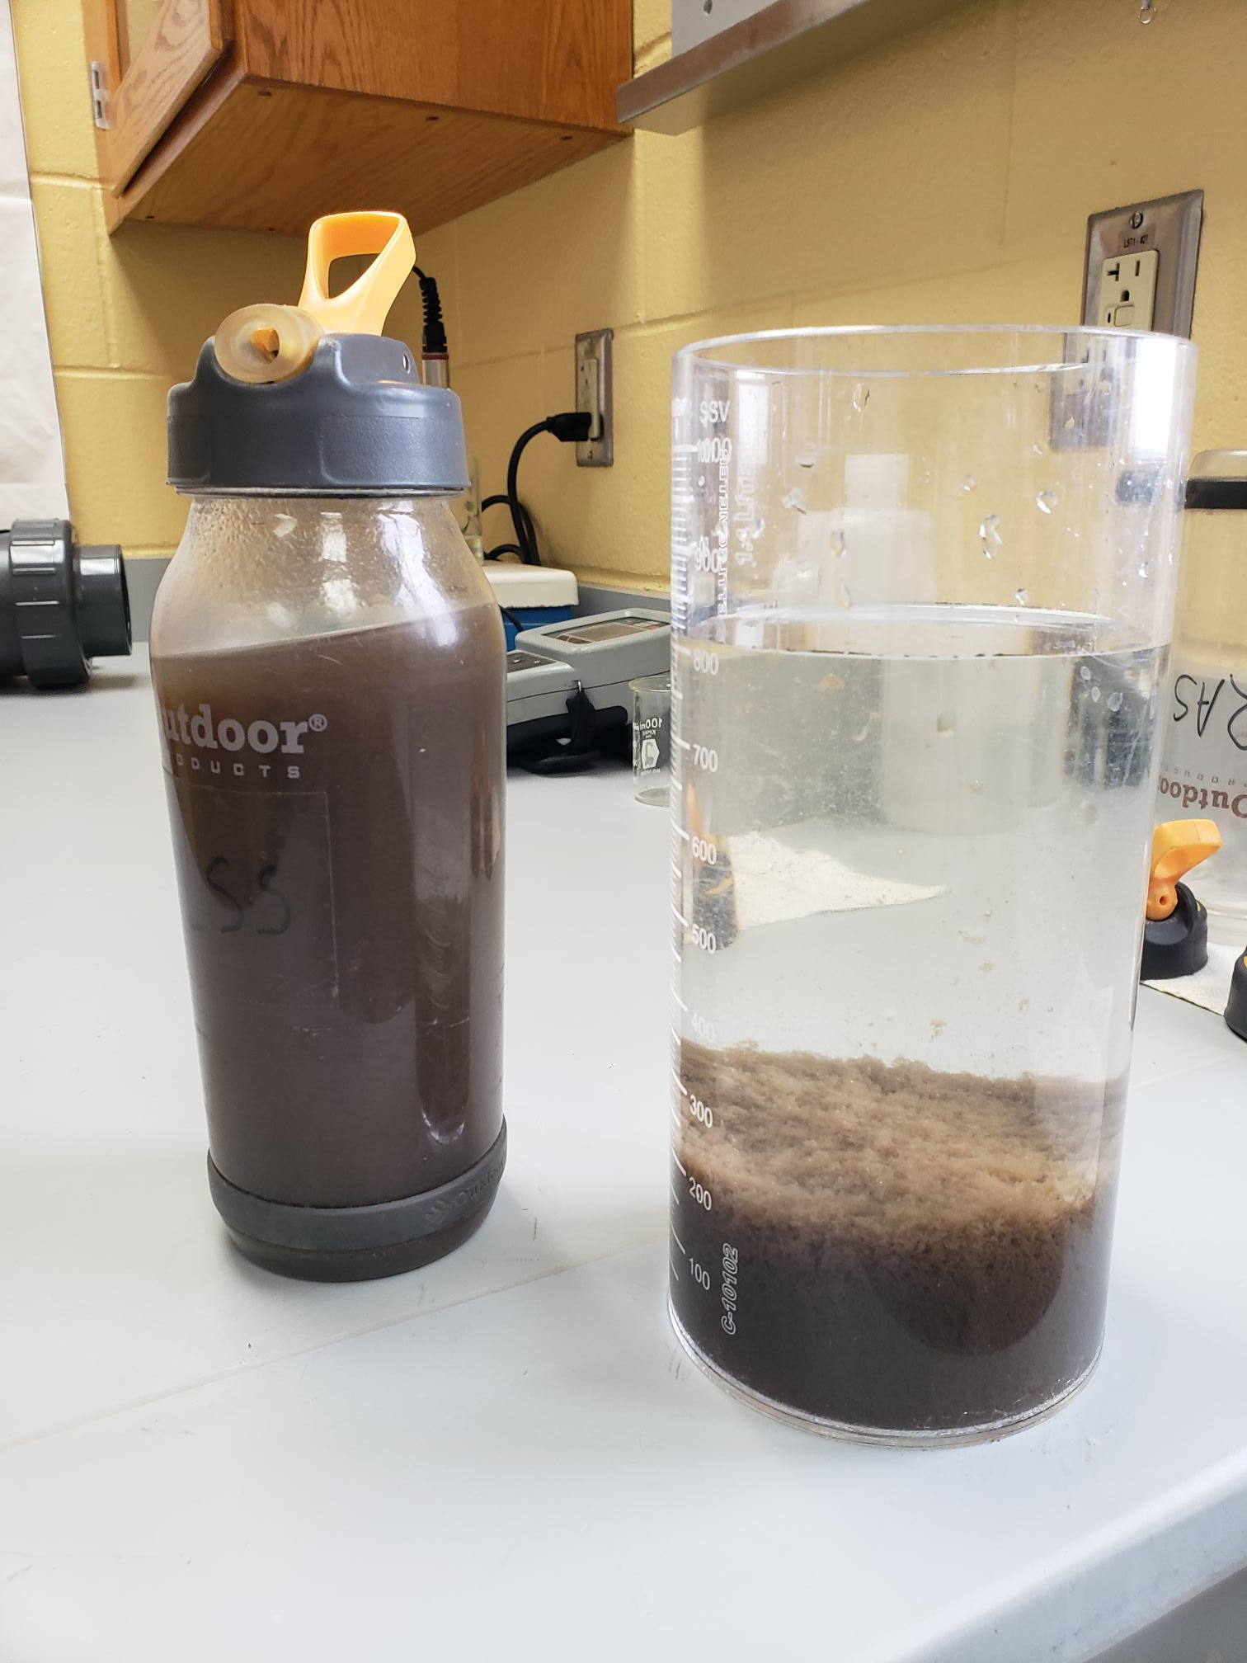

Slide 12
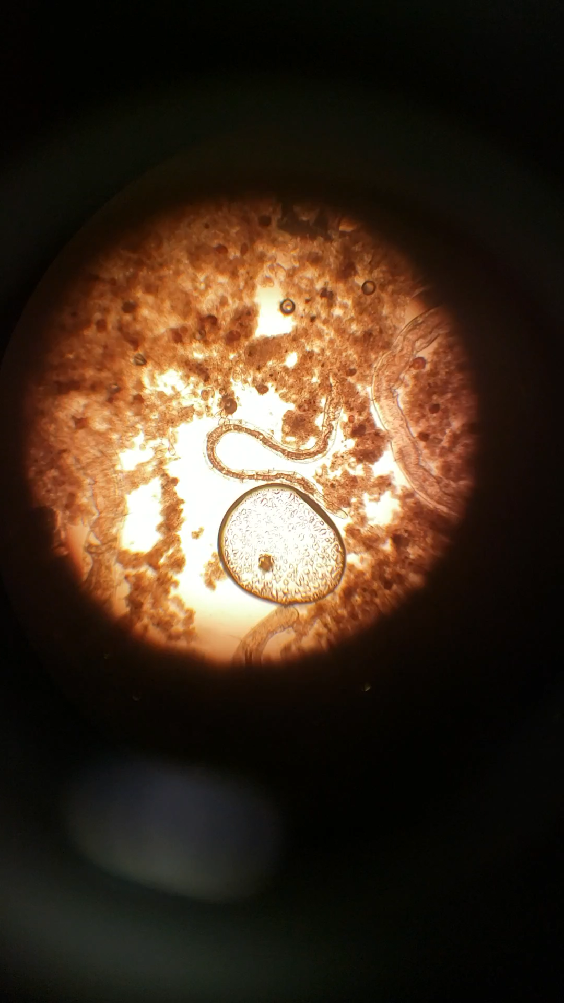
Notes:
For kids who love biology- this is a video of water bugs.

Slide 13
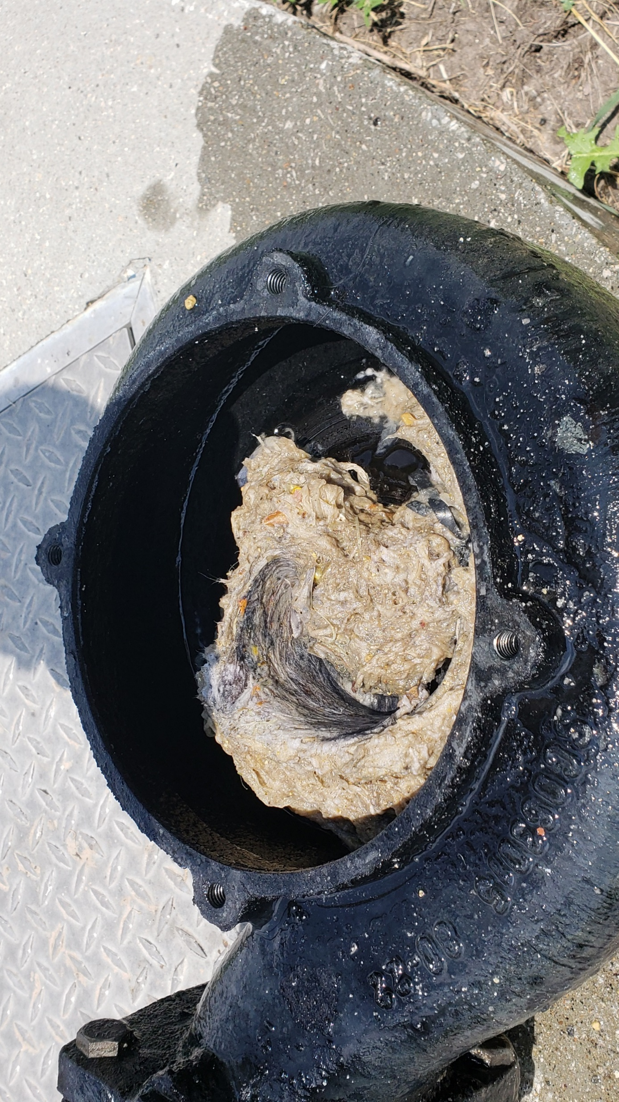
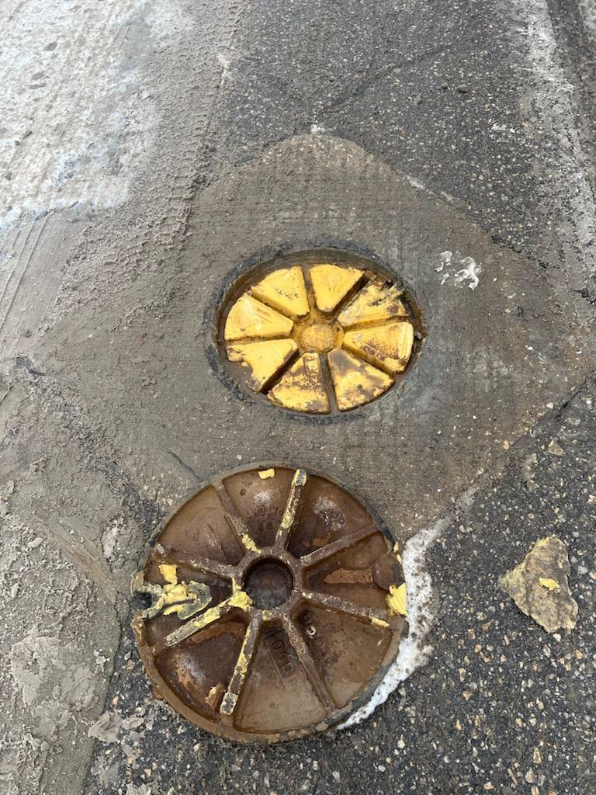
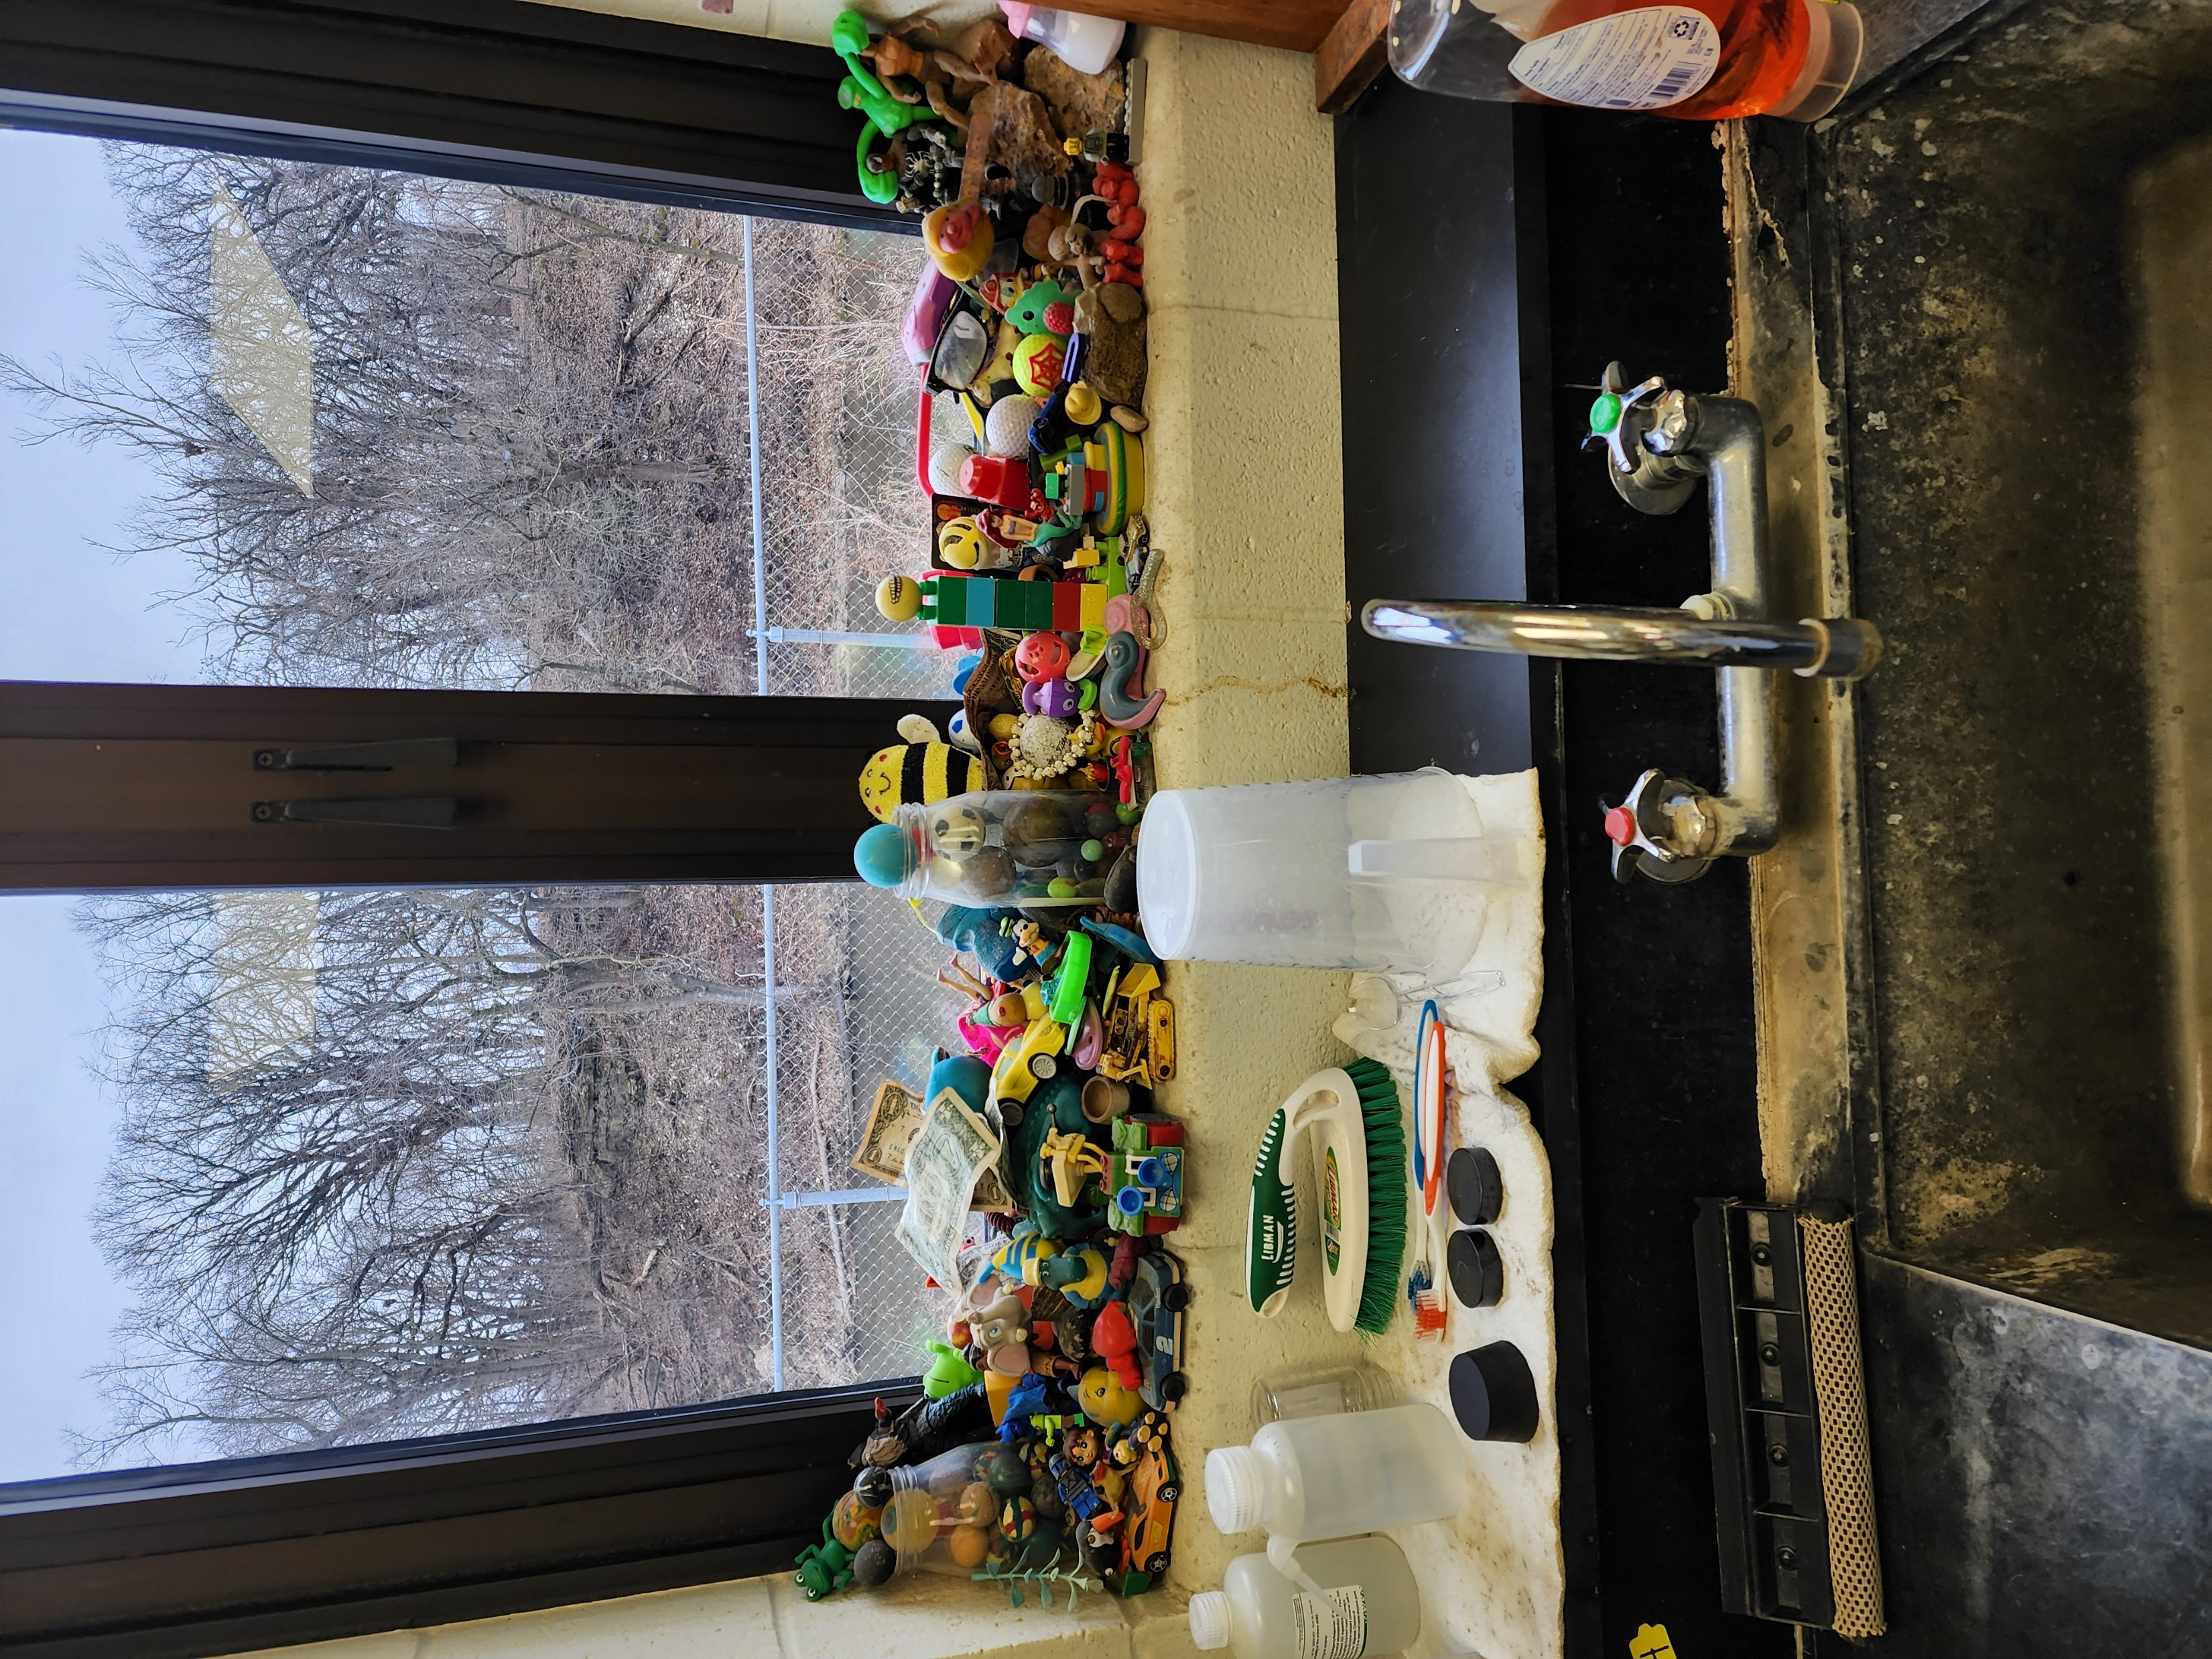
Notes:
There are things that should not go down a drain or toilet. Let’s look at our jars, how are they looking?
Is the wipe still in one piece?
Top left is grease and oil used for cooking. This was disposed of improperly at a commercial site. Top right, can you guess what that is? Flushable wipes. Do you think flushable wipes are in fact flushable? And then the bottom picture is a collection of things retrieved at a wastewater plant. These items made it all the way to the plant.
( You can talk about anything you have seen that is interesting, if it is unique to your site.)

Slide 14
What does a Career in Water Look like?
(Insert your photos here! Show off your site!
Notes:
( Add in pictures of you at work, your employees, operators, contractors, etc. JAG students do not get to travel a lot, so if you have worked in a lot of different locations, you can share those experiences for a minute or two.)

Slide 15
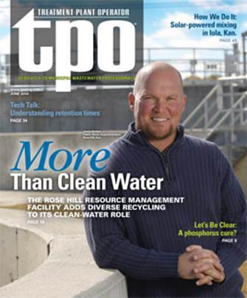
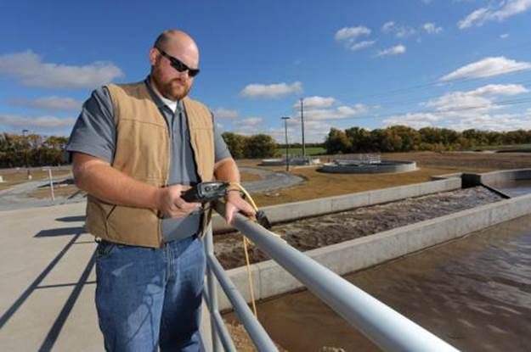
Careers in Water and Wastewater
Operator
Notes:
( you are welcome to update these with your own photos. Give a brief description of job duties for each role. If you do not have this employee, or work with this employee then delete it from your presentation. Or you can talk about how these other careers are necessary you just may not have experience. Use Quotes as needed.)
“Recycling is more than pop cans and plastic bottles. We recycle water. There is no new water being made, so we have to recycle what we have. At a wastewater treatment plant that’s what we do. We turn wastewater into clean water and put it back into nature to get used by someone else.”

Slide 16
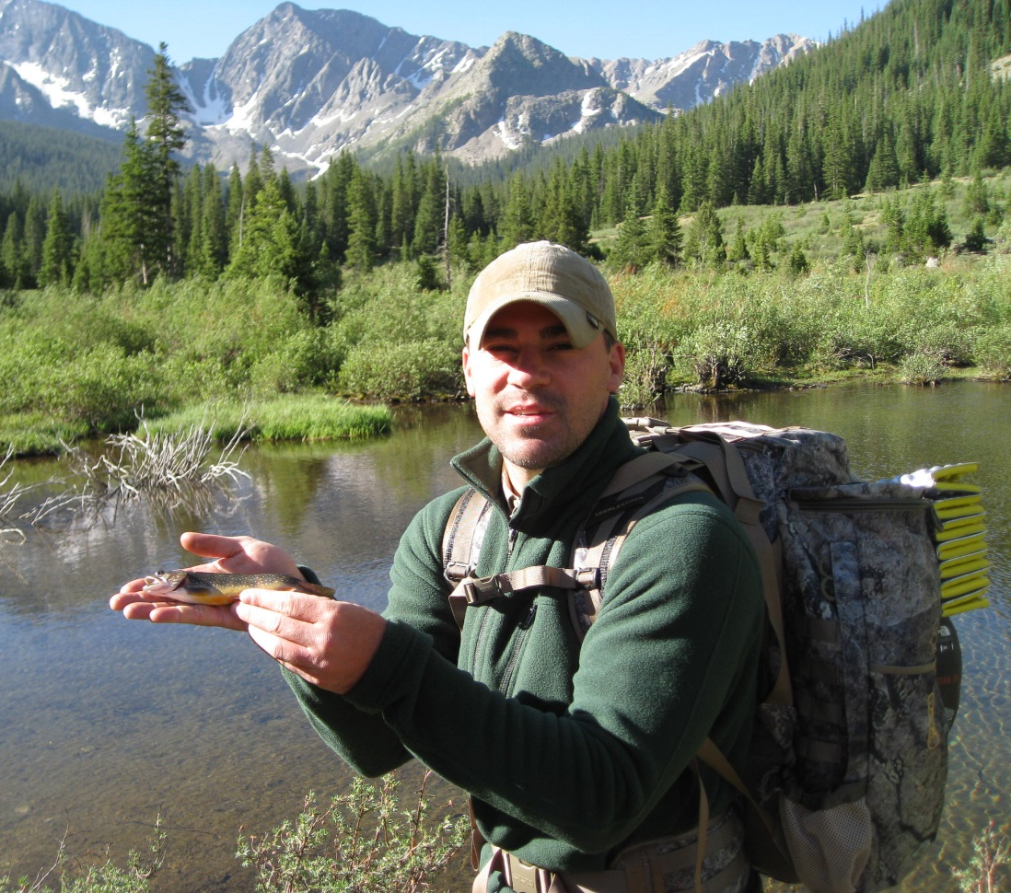
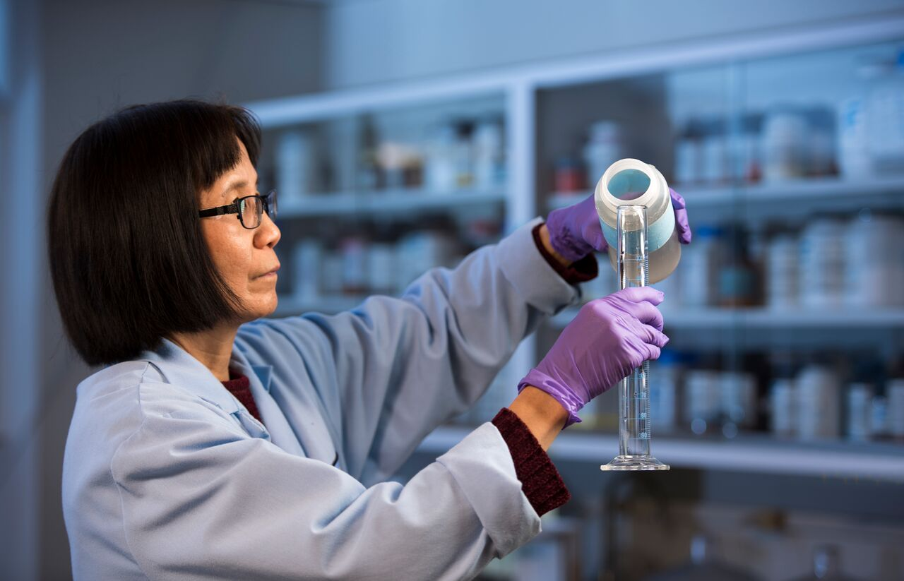
Careers in Water and Wastewater
Regulator
Chemist
Notes:
Regulator: My job affords me the opportunity to protect both the public and environmental health. I accomplish this by enforcing regulations and providing technical and financial assistance. My job challenges me to develop creative approaches to achieve compliance
Chemist: Working in a wastewater laboratory is challenging and interesting. With a wide variety of analytical work needed to evaluate processes and meet discharge permit regulations, you will never be bored.

Slide 17
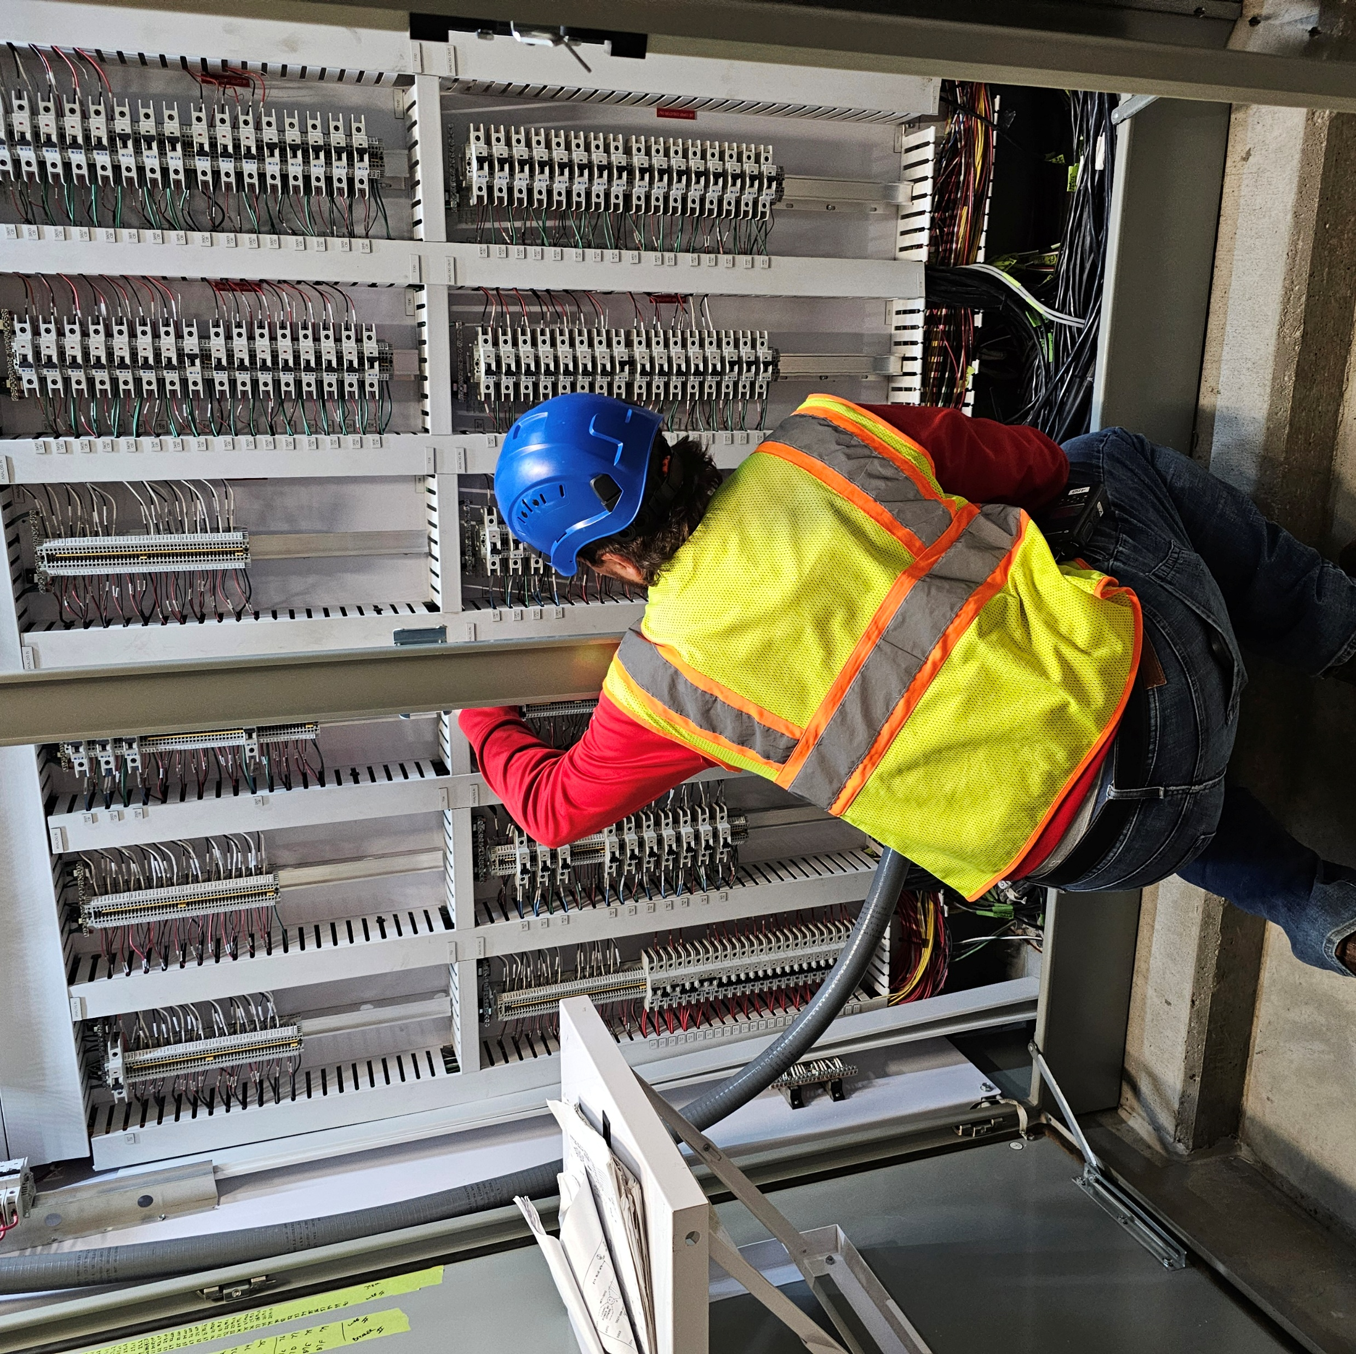

Careers in Water and Wastewater
Instrument, Electrical, and control Specialist
Operational Technology and Cyber Security
Notes:
Control Specialist: “Water treatment facilities rely heavily on communication systems, automation, sensors, and controls to ensure safe and reliable water for the community.”
OT and Cyber: “I never envisioned my career path leading to a water treatment plant, but the transition has been incredibly rewarding. During my years in the Air Force, I learned the true value of working alongside a dedicated team focused on a single, vital mission: Protecting the American People. Today, working in OT Cybersecurity for the City of Wichita gives me the exact same sense of fulfillment. Its an honor to continue serving by protecting the critical cyber-physical systems that Wichita citizens rely on every single day.”

Slide 18
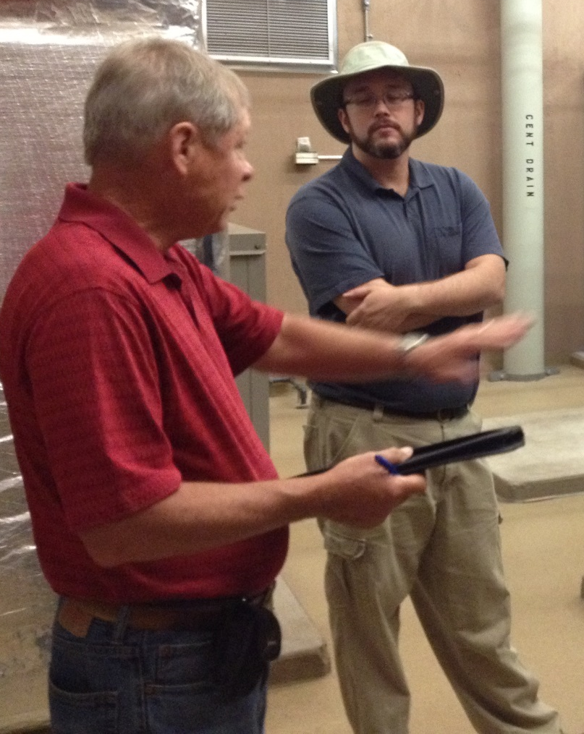
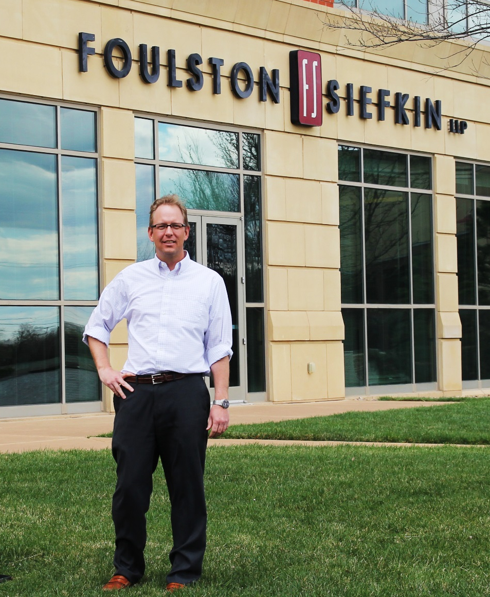
Careers in Water and Wastewater
Engineer
Lawyer
Notes:
Engineer: I help design and build water supply systems. I feel like I’m doing something important for the generations to come.
Lawyer: Water attorneys help people comply with the law, conduct complex transactions involving water issues and handle litigation between competing water users. I grew-up on a farm in SW Kansas, obtaining and preserving adequate water has always been important to me. The complexity and competition involved in obtaining and keeping water rights keeps my water-law practice interesting and rewarding.

Slide 19
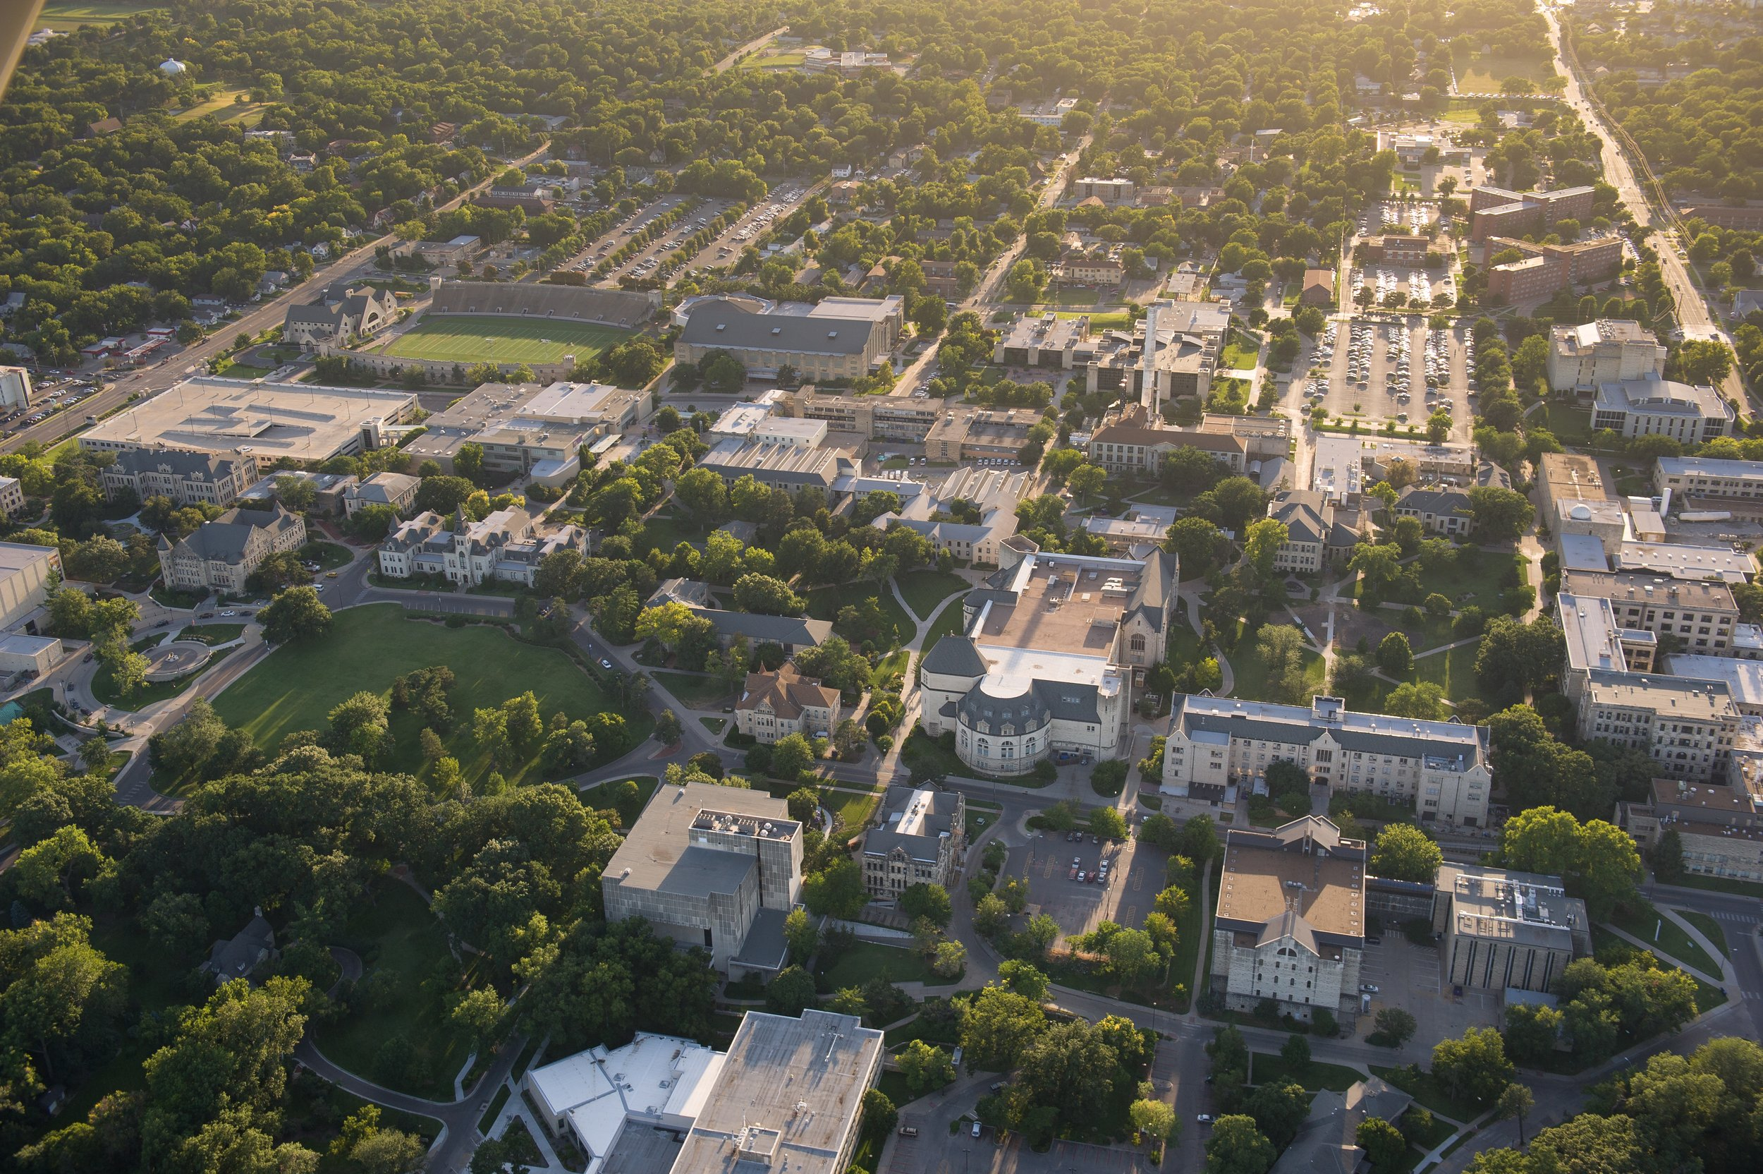
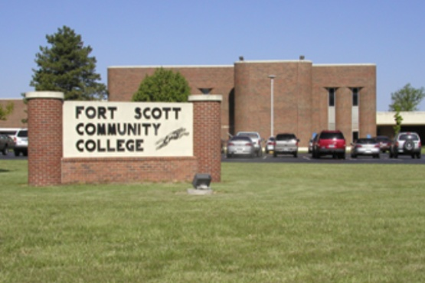
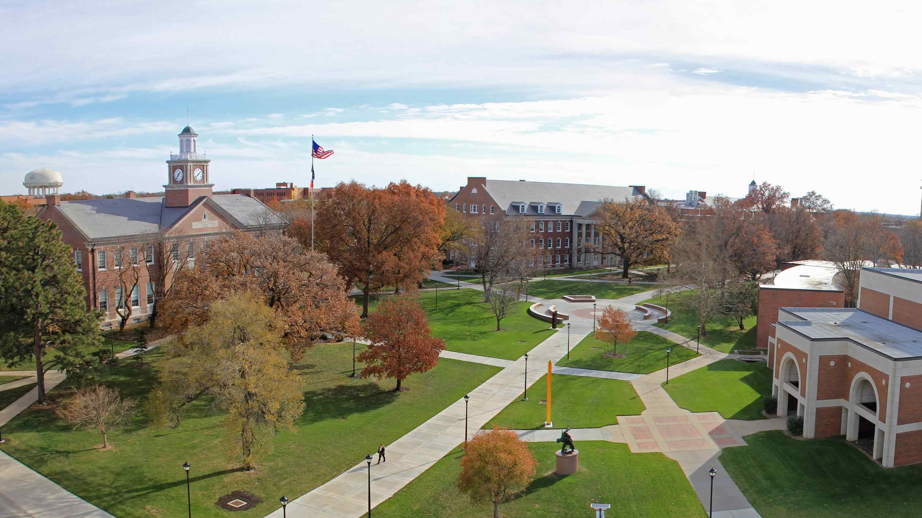
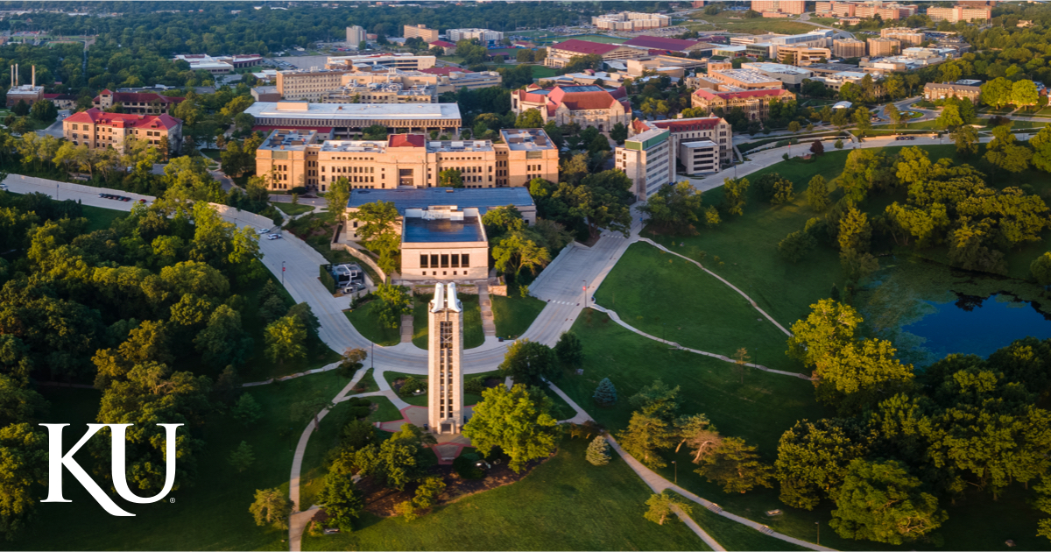
What comes after high school?
Notes:
(Talk about career and education options after high school. You can tell them about your journey to the career and why you stay! You can replace these photos on this slide with pictures of where you went to school or received training, maybe even your first job!)
As you can see there are a lot of career options in the Water Workforce. Some of these careers can be obtained through on the job training. Some of them require different degrees from a university or community college. No matter what, there are a lot of options when it comes to careers and education. Through a group called the Kansas Water Intern Committee, utilities can get funded for internships at different sites across the state. These internships allow students to test out what it would be like working in the water workforce. If this is something you would like to try, come talk to us!

Slide 20
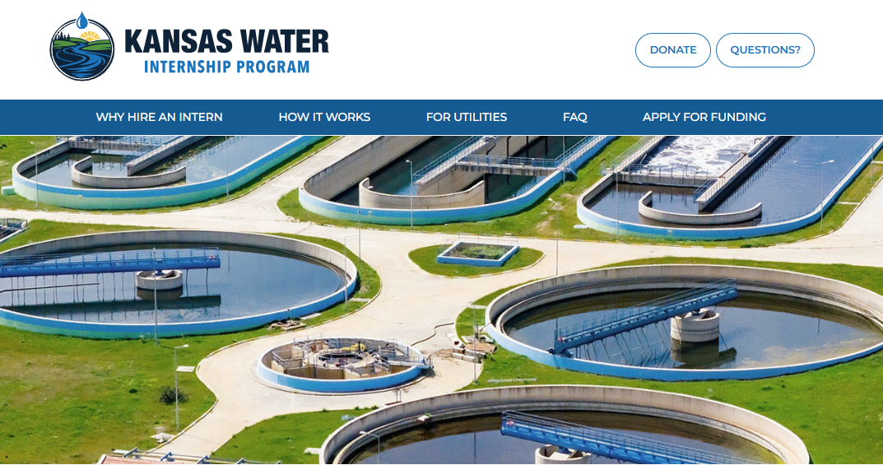
Notes:
The Kansas Water Internship Program (KWIP) is a joint effort of the Kansas Section of the American Water Works Association and the Kansas Water Environment Association.
Their mission is to educate and train the next generation of the water workforce through funded internships within the state of Kansas.
The Kansas Water Internship Program (KWIP) Committee is dedicated to growing and retaining the water and wastewater workforce throughout the state.
Check this site often! They will post updates for application opportunities and information regarding internships in Kansas!

Slide 21
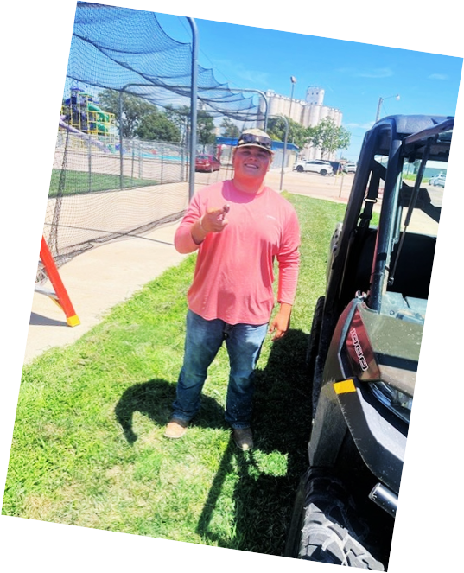
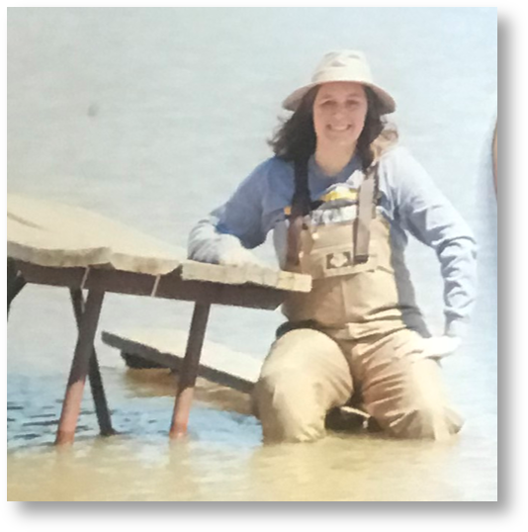
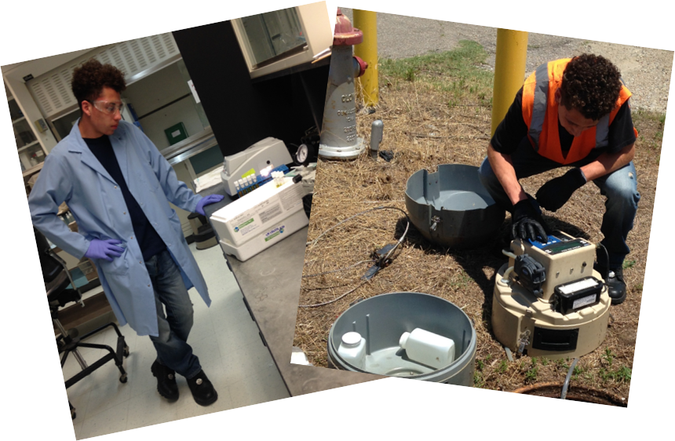
“My career aspirations: I have not yet decided. But water Management has a lot of great careers and job opportunities.”
- Carson Watkins, Quinter, KS Intern
“I want to pursue a career in the utilities field. It’s hands-on, interesting, and it feels good knowing you’re helping people and making a difference in your community.”
- Logan Basgall, Derby, KS Intern
Notes:
Here are some photos of interns at work. A lot of them were able to engage in a variety of activities.
On the Resources for Utilities - Environmental Finance Center Network, you can view interviews with Kansas interns and their Supervisors. You are welcome to imbed those interviews here if you would like.
These students have worked in internships and the picture of the girl in the top comer even changed her whole career plans because she loved her experience! An internship is a great way to get introduced.

Slide 22

Wrap up and Questions
Notes:
Lets discuss a few questions from the class about anything they learned today.

Slide 23
Video
https://youtu.be/YxW_PxzsGxg
Notes:
This is a video about Kansas City Water. You can use it if you would like. It could be used for an introduction.

Slide 24
Notes:
Local Job postings, field trips, job shadows, information specific to your site and

Slide 25
Notes:
Thank you contact information

